Slide 1

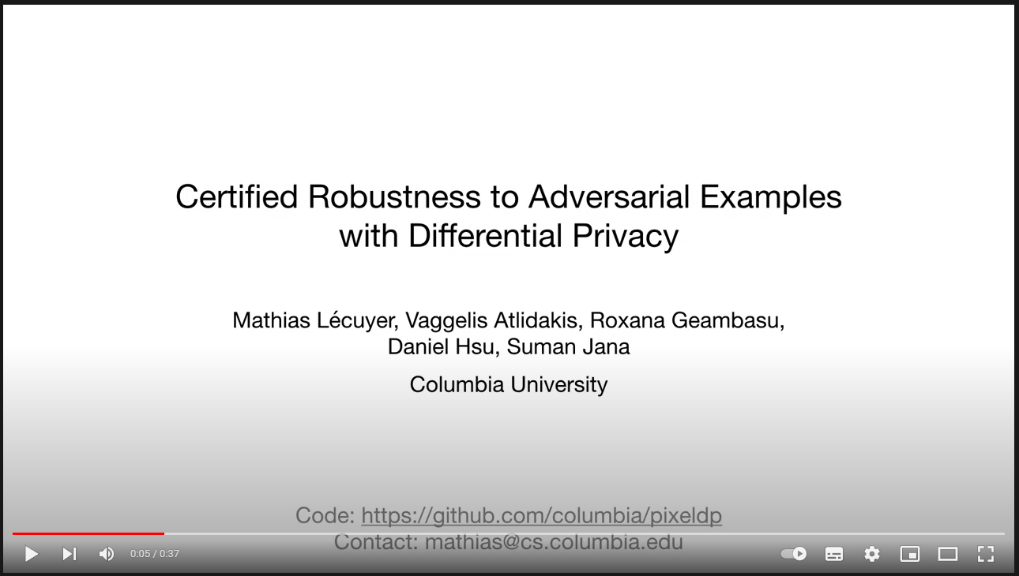
Certified Robustness to Adversarial Examples with Differential Privacy
Mathias Lecuyer, … , Suman Jana
Columbia University
IEEE S&P 2019

Slide 2
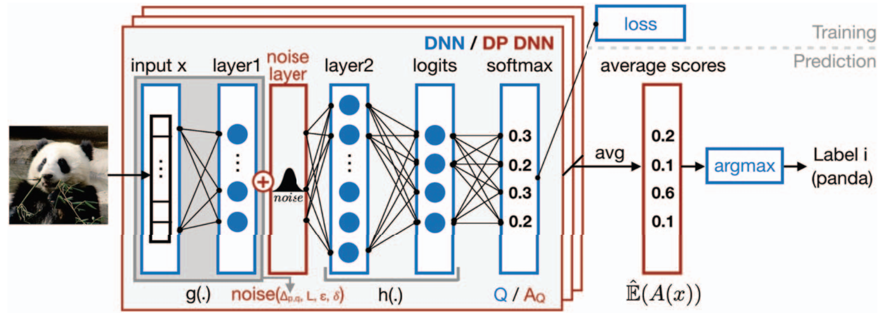
Differential Privacy
Overview
Design a DNN classifier with differential privacy properties
Essence: Introduce randomness into the prediction of the classifier.
Way: Add a noise layer to the network.
Purpose: Guarantee that the output of the model is insensitive to small
changes in the input.
Lecuyer, Mathias. Certified robustness to adversarial examples with differential privacy. IEEE S&P 2019.

Slide 3
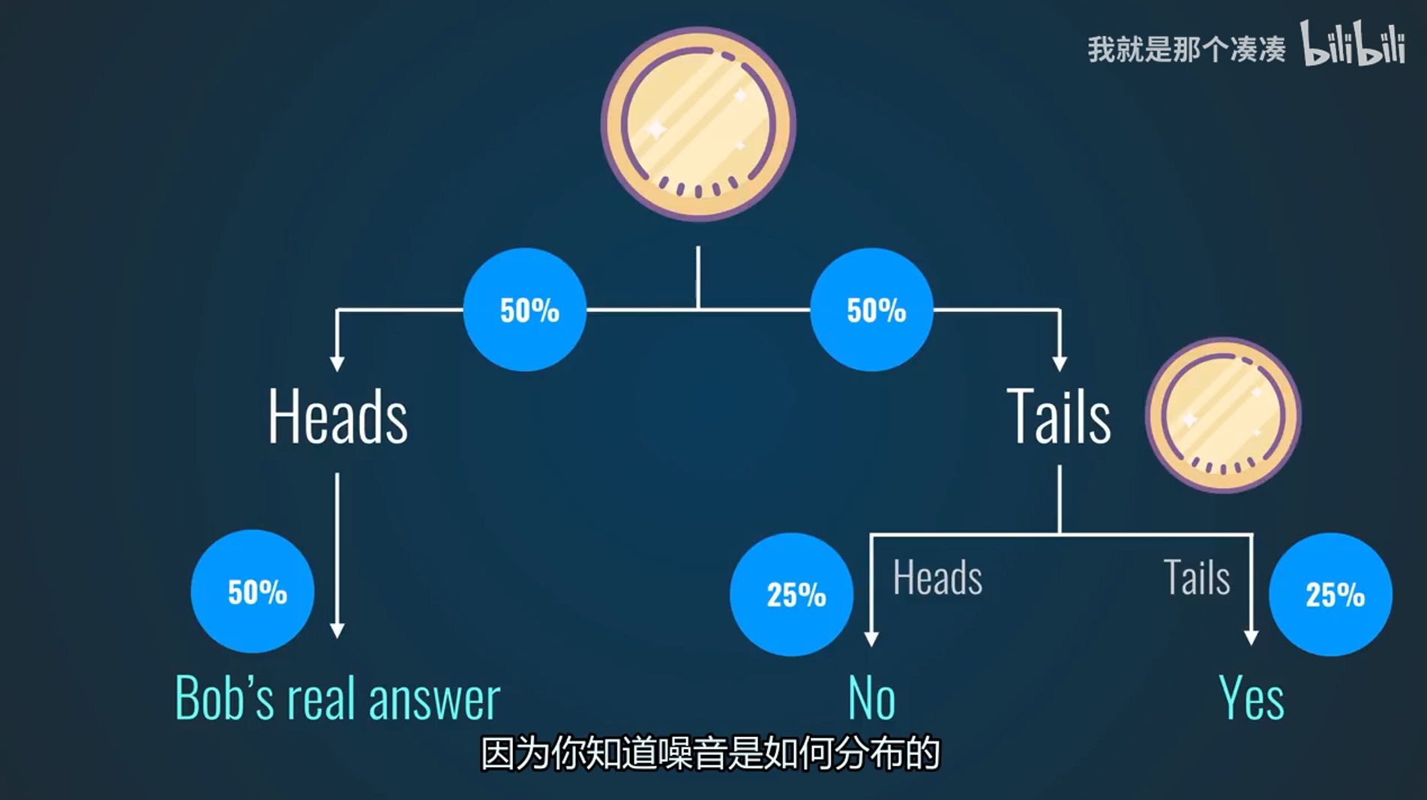
Differential Privacy
Preliminary
Differential Privacy
Randomize responses
Lecuyer, Mathias. Certified robustness to adversarial examples with differential privacy. IEEE S&P 2019.

Slide 4
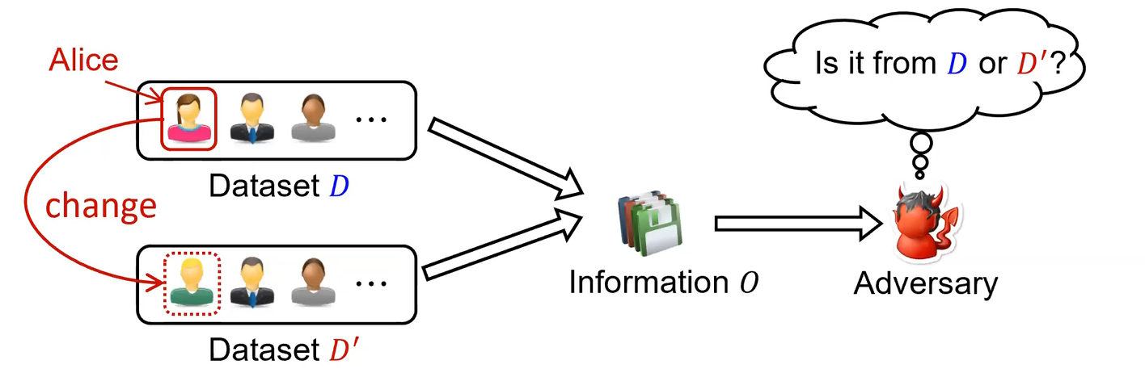
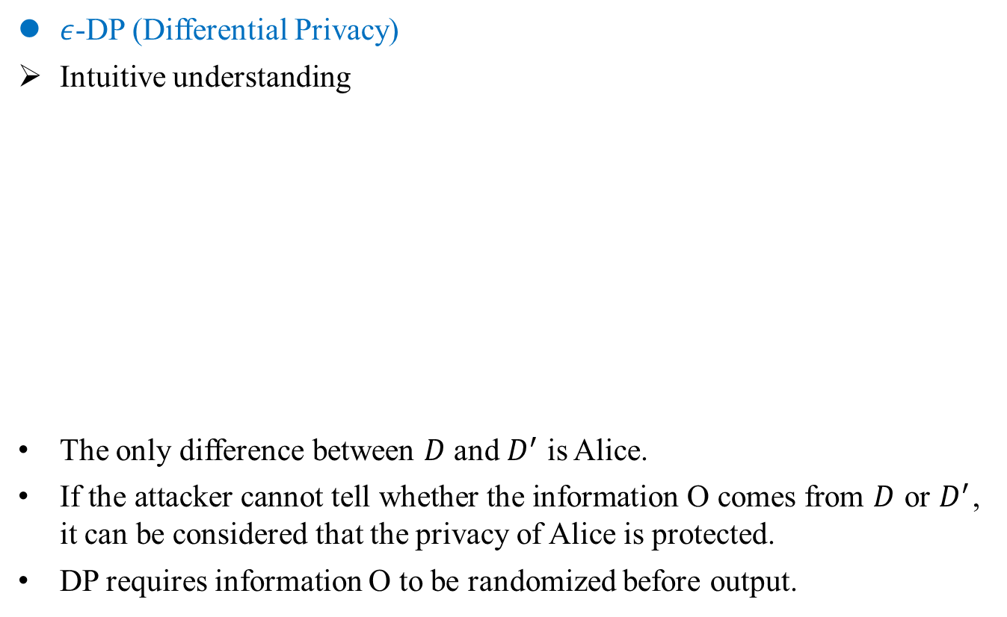
Differential Privacy
Preliminary
$ε$-DP (Differential Privacy)
Intuitive understanding
The only difference between $D$ and $D^{′}$ is Alice.
If the attacker cannot tell whether the information O comes from $D$ or $D^{′}$, it can be considered that the privacy of Alice is protected.
DP requires information O to be randomized before output.
Lecuyer, Mathias. Certified robustness to adversarial examples with differential privacy. IEEE S&P 2019.
Notes:
DP 关注的是对数据库的计算输出是否可以揭示有关数据库中单个记录的信息。
为了防止这种信息泄露，在计算中引入了随机性来隐藏单个记录的细节.

Slide 5
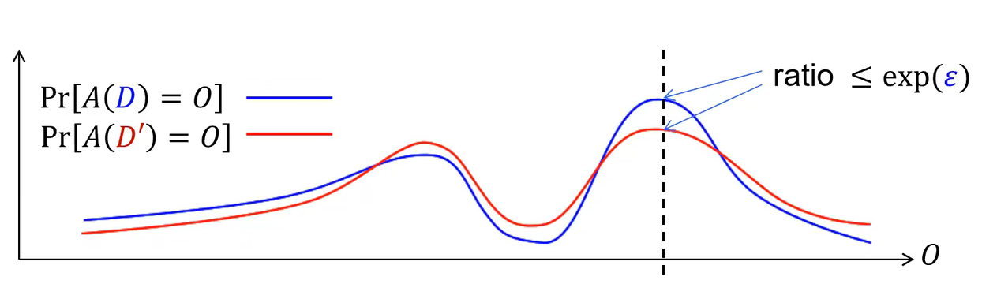
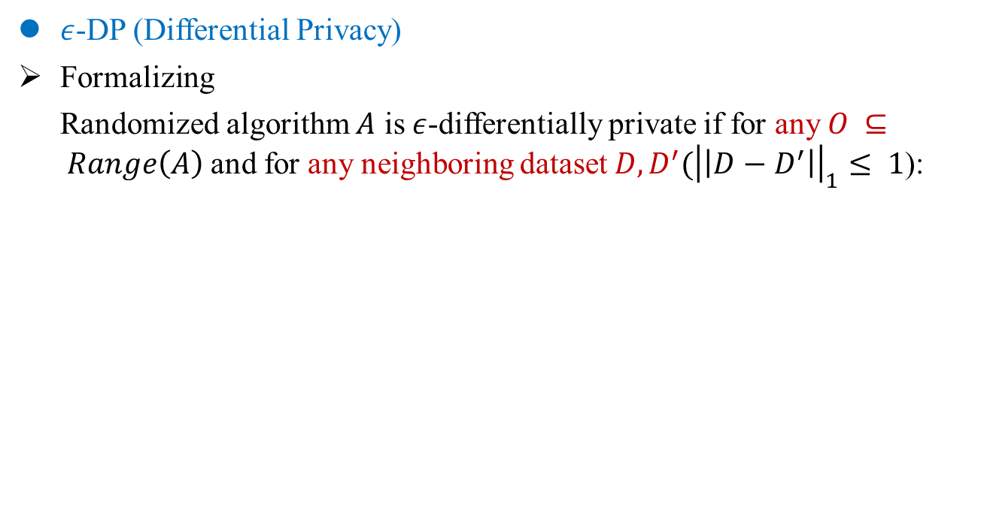
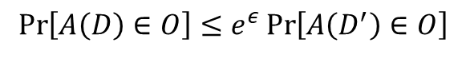
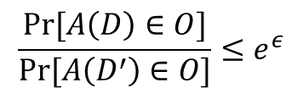
Differential Privacy
Preliminary
$ε$-DP (Differential Privacy)
Formalizing
Randomized algorithm $A$ is $ε$-differentially private if for any $O ⊆ Range\left(A\right)$and for any neighboring dataset $D, D^{′}({\left|\left|D−D^{′}\right|\right|}_{1}≤ 1$):
$$\operatorname{Pr}\left[A\left(D\right)∈O\right]≤e^{ε}\operatorname{Pr}\left[A\left(D^{′}\right)∈O\right]$$
$$\frac{Pr⁡[A\left(D\right)∈O]}{Pr⁡[A\left(D^{′}\right)∈O]}≤e^{ε}$$
Lecuyer, Mathias. Certified robustness to adversarial examples with differential privacy. IEEE S&P 2019.
Notes:
DP 关注的是对数据库的计算输出是否可以揭示有关数据库中单个记录的信息。
为了防止这种信息泄露，在计算中引入了随机性来隐藏单个记录的细节.
差分用来防范差分攻击的

Slide 6
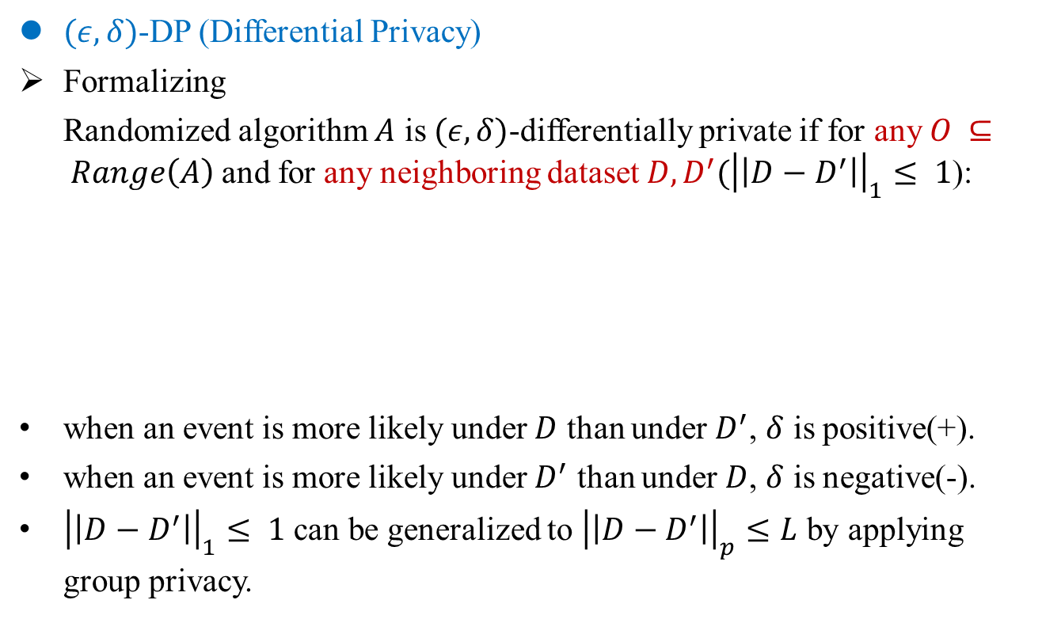
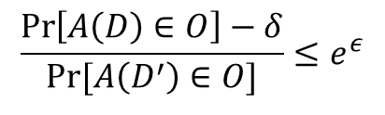
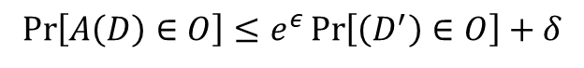
Differential Privacy
Preliminary
$(ε,δ)$-DP (Differential Privacy)
Formalizing
Randomized algorithm $A$ is $(ε,δ)$-differentially private if for any $O ⊆ Range\left(A\right)$and for any neighboring dataset $D, D^{′}({\left|\left|D−D^{′}\right|\right|}_{1}≤ 1$):
when an event is more likely under $D$ than under $D^{′}$, $δ$ is positive(+).
when an event is more likely under $D^{′}$ than under $D$, $δ$ is negative(-).
${\left|\left|D−D^{′}\right|\right|}_{1}≤ 1$ can be generalized to ${\left|\left|D−D^{′}\right|\right|}_{p}≤L$ by applying group privacy.
$$\operatorname{Pr}\left[A\left(D\right)∈O\right]≤e^{ε}\operatorname{Pr}\left[\left(D^{′}\right)∈O\right]+δ$$
$$\frac{\operatorname{Pr}\left[A\left(D\right)∈O\right]−δ}{Pr⁡[A\left(D^{′}\right)∈O]}≤e^{ε}$$
C. Dwork. The algorithmic foundations of differential privacy. Foundations and Trends in Theoretical Computer Science, 2014.
Notes:
DP 关注的是对数据库的计算输出是否可以揭示有关数据库中单个记录的信息。
为了防止这种信息泄露，在计算中引入了随机性来隐藏单个记录的细节.
差分用来防范差分攻击的

Slide 7
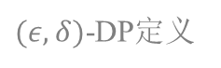
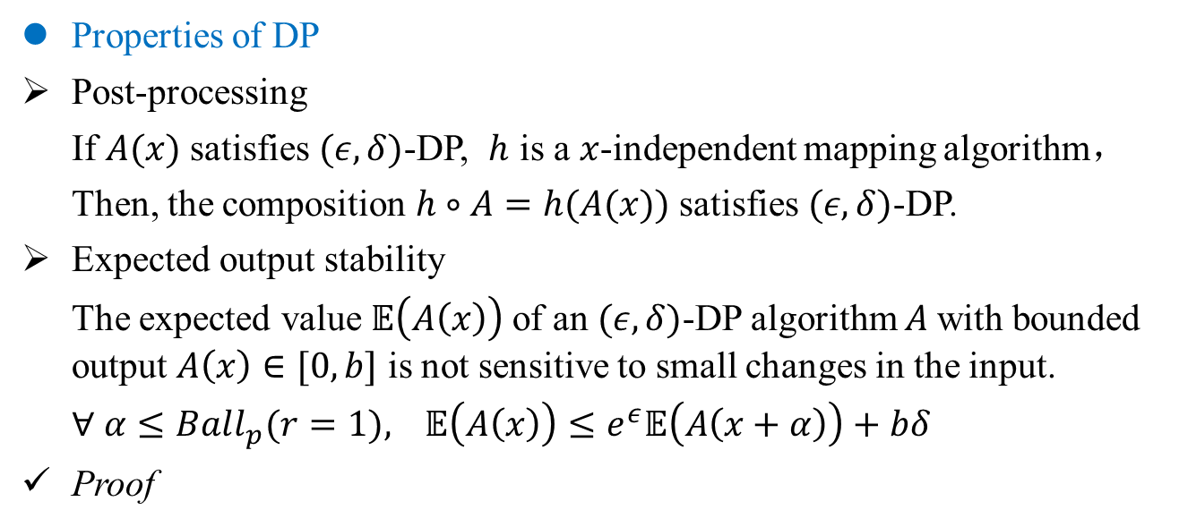
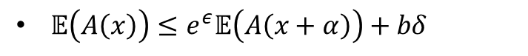
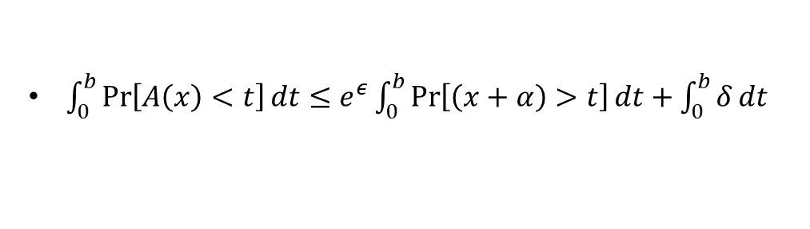
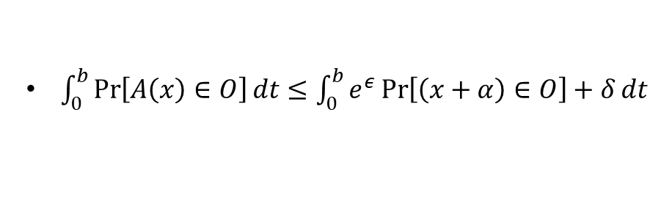
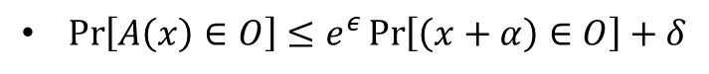
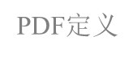
Differential Privacy
Preliminary
Properties of DP
Post-processing
If $A(x)$ satisfies $(ε,δ)$-DP, $h$ is a $x$-independent mapping algorithm，
Then, the composition $h∘A=h(A(x))$satisfies $(ε,δ)$-DP.
Expected output stability
The expected value $𝔼\left(A\left(x\right)\right)$of an $(ε,δ)$-DP algorithm $A$with bounded output $A\left(x\right)∈[0,b]$ is not sensitive to small changes in the input.
$∀ α≤Ball_{p}(r=1),$ $𝔼\left(A\left(x\right)\right)≤e^{ε}𝔼\left(A\left(x+α\right)\right)+bδ$
Proof
$\operatorname{Pr}\left[A\left(x\right)∈O\right]≤e^{ε}\operatorname{Pr}\left[\left(x+α\right)∈O\right]+δ$
$(ε,δ)$-DP定义
$\int_{0}^{b}{\operatorname{Pr}\left[A\left(x\right)∈O\right]}dt≤\int_{0}^{b}{e^{ε}\operatorname{Pr}\left[\left(x+α\right)∈O\right]+δ}dt$
积分
$\int_{0}^{b}{\operatorname{Pr}\left[A\left(x\right)<t\right]}dt≤e^{ε}\int_{0}^{b}{\operatorname{Pr}\left[\left(x+α\right)>t\right]}dt+\int_{0}^{b}{δ}dt$
PDF$定义$
$𝔼\left(A\left(x\right)\right)≤e^{ε}𝔼\left(A\left(x+α\right)\right)+bδ$
期望定义
Lecuyer, Mathias. Certified robustness to adversarial examples with differential privacy. IEEE S&P 2019.

Slide 8
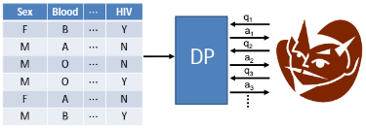
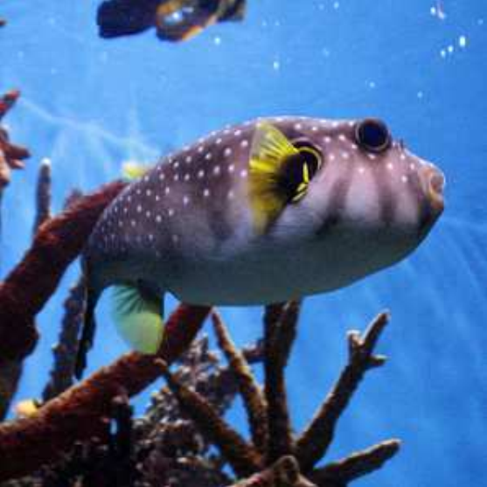

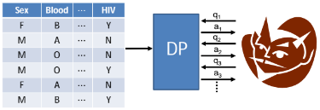
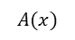
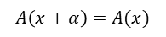
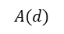
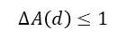
Differential Privacy
DP-robustness Connection
One-to-one correspondence
Differential Privacy
Databases
Randomized query algorithm
Records in a database
Adversarial Robustness
Input images
Randomized classify algorithm
Pixels in an images
Remove/alter on records
Result in a bounded change in the output
Increase or decrease pixels
Result in a bounded change in the prediction
$$A(d)$$
$$A(x)$$
$$∆A\left(d\right)≤1$$
$$A\left(x+α\right)=A(x)$$
Lecuyer, Mathias. Certified robustness to adversarial examples with differential privacy. IEEE S&P 2019.

Slide 9
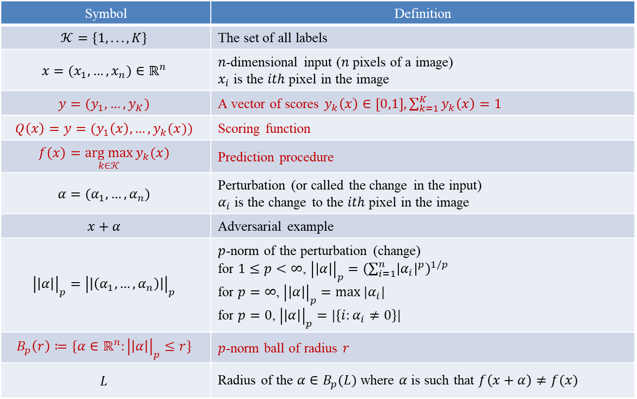
Differential Privacy
Notation
Symbol | Definition
$$𝒦=\{1, . . . , K\}$$ | The set of all labels
$$x=(x_{1},…,x_{n})∈ℝ^{n}$$ | $n$-dimensional input ($n$ pixels of a image) $x_{i}$ is the $ith$ pixel in the image
$$y=(y_{1},…,y_{K})$$ | A vector of scores $y_{k}\left(x\right)∈\left[0,1\right], \sum_{k=1}^{K}{y_{k}\left(x\right)}=1$
$$Q\left(x\right)=y=(y_{1}\left(x\right),…,y_{k}(x))$$ | Scoring function
$$f\left(x\right)=\underset{k∈𝒦}{arg max}{y_{k}(x)}$$ | Prediction procedure
$$α=(α_{1},…,α_{n})$$ | Perturbation (or called the change in the input) $α_{i}$ is the change to the $ith$ pixel in the image
$$x+α$$ | Adversarial example
$${\left|\left|α\right|\right|}_{p}={\left|\left|\left(α_{1},…,α_{n}\right)\right|\right|}_{p}$$ | $p$-norm of the perturbation (change) for $1≤p<∞$, ${\left|\left|α\right|\right|}_{p}={\left(\sum_{i=1}^{n}{{\left|α_{i}\right|}^{p}}\right)}^{1/p}$ for $p=∞$, ${\left|\left|α\right|\right|}_{p}=max⁡|α_{i}|$ for $p=0$, ${\left|\left|α\right|\right|}_{p}=|\{i:α_{i}≠0\}|$
$$B_{p}\left(r\right)≔\{α∈ℝ^{n}:{\left|\left|α\right|\right|}_{p}≤r\}$$ | $p$-norm ball of radius $r$
$$L$$ | Radius of the $α∈B_{p}(L)$ where $α$ is such that $f\left(x+α\right)≠f(x)$
Lecuyer, Mathias. Certified robustness to adversarial examples with differential privacy. IEEE S&P 2019.

Slide 10
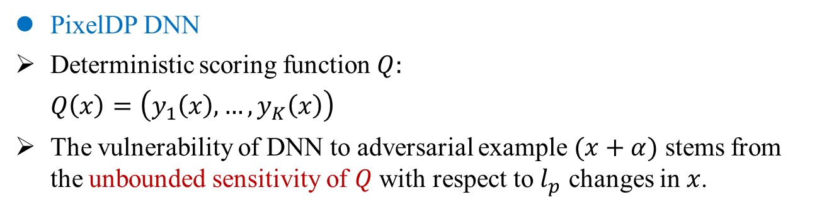
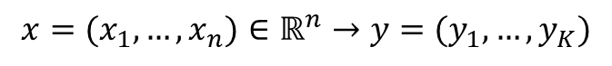
Differential Privacy
PixelDP classifier
PixelDP DNN
Deterministic scoring function $Q:$
$Q\left(x\right)=\left(y_{1}\left(x\right),…,y_{K}\left(x\right)\right)$
The vulnerability of DNN to adversarial example $(x+α)$ stems from the unbounded sensitivity of $Q$ with respect to $l_{p}$ changes in $x$.
$$x=(x_{1},…,x_{n})∈ℝ^{n}→y=(y_{1},…,y_{K})$$
Lecuyer, Mathias. Certified robustness to adversarial examples with differential privacy. IEEE S&P 2019.
Notes:
蓝色为原始 DNN。
红色表示提供 (, δ)-DP 保证的噪声层。
噪声可以添加到输入或任何以下层，但分布由噪声层之前的每一层执行的计算的灵敏度 Δp,q 重新调整。
DNN 使用原始损失和优化器（例如 Momentum 随机梯度下降）进行训练。
预测反复调用 (, δ)-DP DNN 来衡量其对分数的经验期望

Slide 11
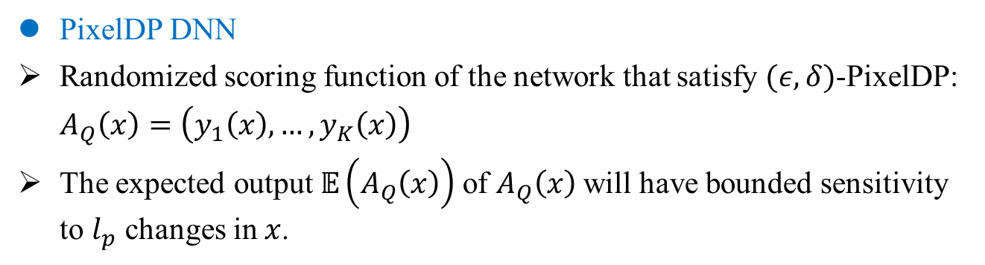
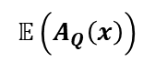
Differential Privacy
PixelDP classifier
PixelDP DNN
Randomized scoring function of the network that satisfy $(ε,δ)$-PixelDP:
$A_{Q}\left(x\right)=\left(y_{1}\left(x\right),…,y_{K}\left(x\right)\right)$
The expected output $𝔼\left(A_{Q}\left(x\right)\right)$of $A_{Q}\left(x\right)$will have bounded sensitivity to $l_{p}$ changes in $x$.
$$𝔼\left(A_{Q}\left(x\right)\right)$$
Lecuyer, Mathias. Certified robustness to adversarial examples with differential privacy. IEEE S&P 2019.
Notes:
蓝色为原始 DNN。
红色表示提供 (, δ)-DP 保证的噪声层。
噪声可以添加到输入或任何以下层，但分布由噪声层之前的每一层执行的计算的灵敏度 Δp,q 重新调整。
DNN 使用原始损失和优化器（例如 Momentum 随机梯度下降）进行训练。
预测反复调用 (, δ)-DP DNN 来衡量其对分数的经验期望

Slide 12
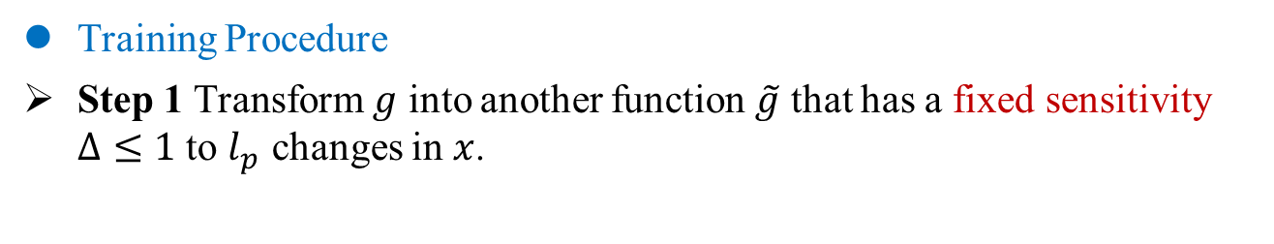
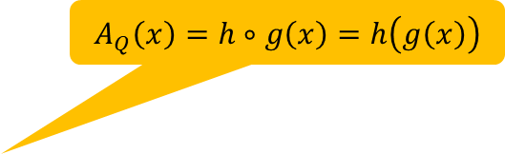

Differential Privacy
PixelDP classifier
Training Procedure
Step 1 Transform $g$ into another function $\tilde{g}$ that has a fixed sensitivity $Δ≤1$ to $l_{p}$ changes in $x$.
$$A_{Q}\left(x\right)=h∘g\left(x\right)=h\left(g\left(x\right)\right)$$
Pre-noise
computation
Subsequent computation
Lecuyer, Mathias. Certified robustness to adversarial examples with differential privacy. IEEE S&P 2019.
Notes:
蓝色为原始 DNN。
红色表示提供 (, δ)-DP 保证的噪声层。
噪声可以添加到输入或任何以下层，但分布由噪声层之前的每一层执行的计算的灵敏度 Δp,q 重新调整。
DNN 使用原始损失和优化器（例如 Momentum 随机梯度下降）进行训练。
预测反复调用 (, δ)-DP DNN 来衡量其对分数的经验期望

Slide 13
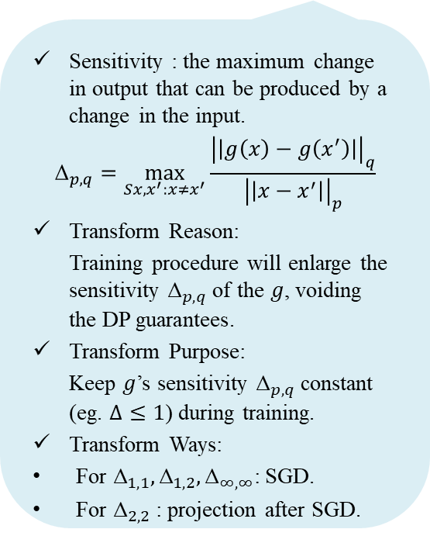
Differential Privacy
PixelDP classifier
Training Procedure
Step 1 Transform $g$ into another function $\tilde{g}$ that has a fixed sensitivity $Δ≤1$ to $l_{p}$ changes in $x$.
Sensitivity : the maximum change in output that can be produced by a change in the input.
$${\text{Δ}}_{p,q}=\max_{Sx,x^{′}:x≠x^{′}}{\frac{{\left|\left|g\left(x\right)−g\left(x^{′}\right)\right|\right|}_{q}}{{\left|\left|x−x^{′}\right|\right|}_{p}}}$$
Transform Reason:
Training procedure will enlarge the sensitivity ${\text{Δ}}_{p,q}$of the $g$, voiding the DP guarantees.
Transform Purpose:
Keep $g$’s sensitivity ${\text{Δ}}_{p,q}$ constant (eg. $Δ≤1$) during training.
Transform Ways:
For ${\text{Δ}}_{1,1},{\text{Δ}}_{1,2},{\text{Δ}}_{∞,∞}$: SGD.
For ${\text{Δ}}_{2,2}$: projection after SGD.
Pre-noise
computation
Subsequent computation
Lecuyer, Mathias. Certified robustness to adversarial examples with differential privacy. IEEE S&P 2019.
Notes:
蓝色为原始 DNN。
红色表示提供 (, δ)-DP 保证的噪声层。
噪声可以添加到输入或任何以下层，但分布由噪声层之前的每一层执行的计算的灵敏度 Δp,q 重新调整。
DNN 使用原始损失和优化器（例如 Momentum 随机梯度下降）进行训练。
预测反复调用 (, δ)-DP DNN 来衡量其对分数的经验期望

Slide 14
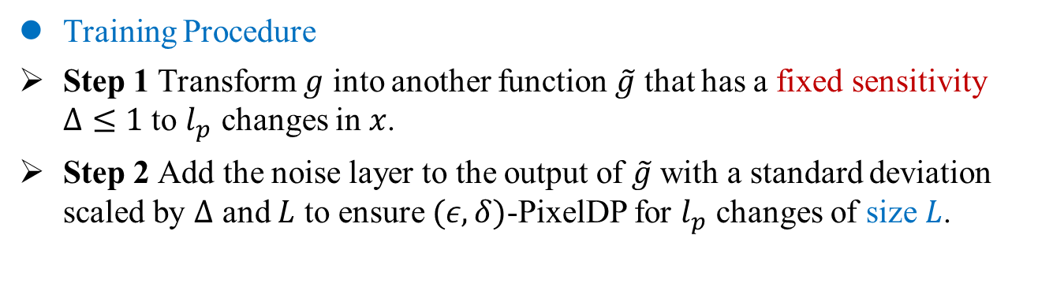
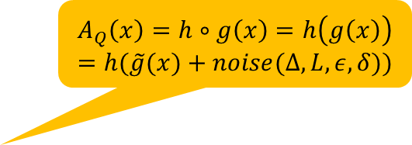
Differential Privacy
PixelDP classifier
Training Procedure
Step 1 Transform $g$ into another function $\tilde{g}$ that has a fixed sensitivity $Δ≤1$ to $l_{p}$ changes in $x$.
Step 2 Add the noise layer to the output of $\tilde{g}$ with a standard deviation scaled by $Δ$ and $L$ to ensure $(ε,δ)$-PixelDP for $l_{p}$ changes of size $L$.
$$A_{Q}\left(x\right)=h∘g\left(x\right)=h\left(g\left(x\right)\right)=h(\tilde{g}(x)+noise(Δ, L, ε, δ))$$
Pre-noise
computation
Subsequent computation
Lecuyer, Mathias. Certified robustness to adversarial examples with differential privacy. IEEE S&P 2019.
Notes:
蓝色为原始 DNN。
红色表示提供 (, δ)-DP 保证的噪声层。
噪声可以添加到输入或任何以下层，但分布由噪声层之前的每一层执行的计算的灵敏度 Δp,q 重新调整。
DNN 使用原始损失和优化器（例如 Momentum 随机梯度下降）进行训练。
预测反复调用 (, δ)-DP DNN 来衡量其对分数的经验期望

Slide 15
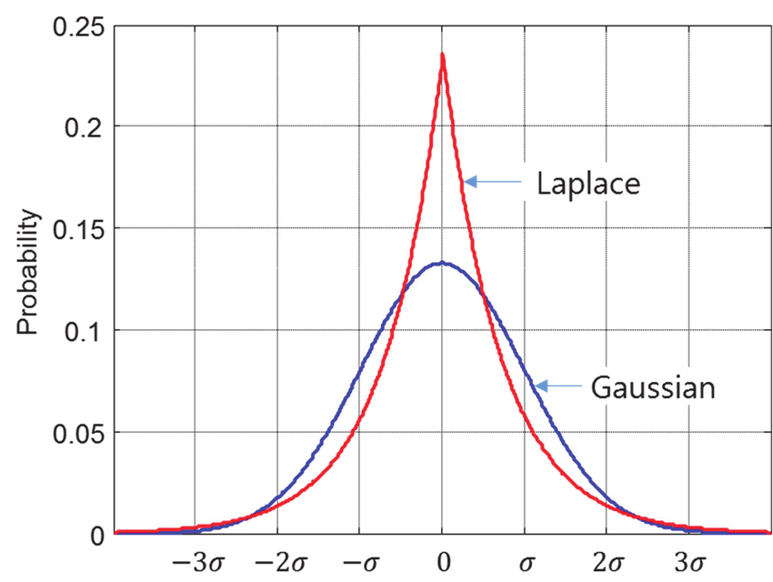
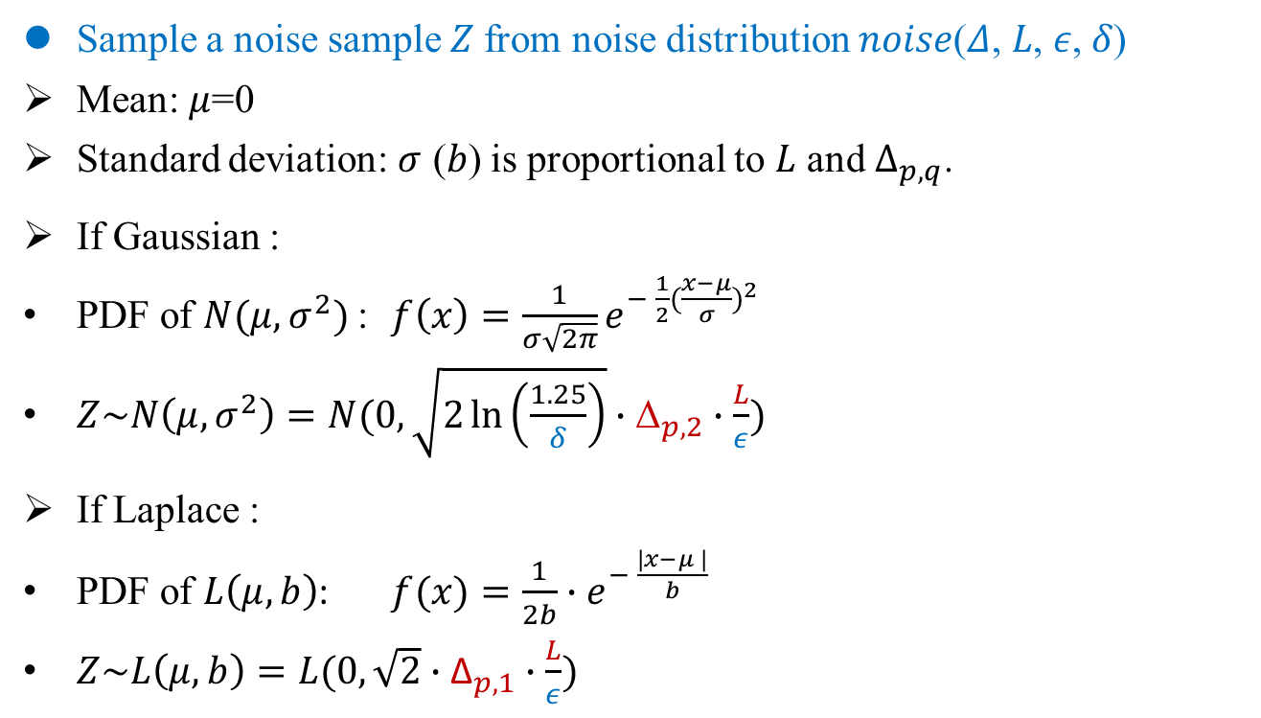
Differential Privacy
Architecture
Sample a noise sample $Z$from noise distribution 𝑛𝑜𝑖𝑠𝑒(𝛥, 𝐿, 𝜖, 𝛿)
Mean: $μ$=0
Standard deviation: $σ$ ($b$) is proportional to $L$ and $Δ_{p,q}$.
If Gaussian :
PDF of $N(μ,σ^{2})$: $f\left(x\right)=\frac{1}{σ\sqrt{2π}}e^{− \frac{1}{2}{(\frac{x−μ}{σ})}^{2}}$
$Z\sim N\left(μ,σ^{2}\right)=N(0, \sqrt{2\ln\left(\frac{1.25}{δ}\right)}∙{\text{Δ}}_{p,2}∙\frac{L}{ε})$
If Laplace :
PDF of $L\left(μ,b\right)$: $f(x)=\frac{1}{2b}$ $∙e^{− \frac{\left|x−μ \right|}{b}}$
$Z\sim L\left(μ,b\right)=L(0,\sqrt{2}∙{\text{Δ}}_{p,1}∙\frac{L}{ε})$
Lecuyer, Mathias. Certified robustness to adversarial examples with differential privacy. IEEE S&P 2019.

Slide 16
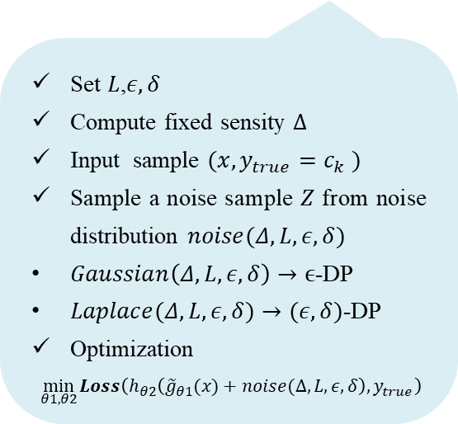
Differential Privacy
PixelDP classifier
Training Procedure
Step 1 Transform $g$ into another function $\tilde{g}$ that has a fixed sensitivity $Δ≤1$ to $l_{p}$ changes in $x$.
Step 2 Add the noise layer to the output of $\tilde{g}$ with a standard deviation scaled by $Δ$ and $L$ to ensure $(ε,δ)$-PixelDP for $l_{p}$ changes of size $L$.
Set $L$,$ε, δ$
Compute fixed sensity $Δ$
Input sample $(x,y_{true}=c_{k} )$
Sample a noise sample $Z$ from noise distribution $noise(Δ, L, ε, δ)$
$Gaussian\left(Δ, L, ε, δ\right)→ϵ$-DP
$Laplace(Δ, L, ε, δ)→(ε,δ)$-DP
Optimization
$\min_{θ1,θ2}{Loss\left(h_{θ2}\left({\tilde{g}}_{θ1}(x)+noise(Δ, L, ε, δ\right),y_{true}\right)}$
$$A_{Q}\left(x\right)=h∘g\left(x\right)=h\left(g\left(x\right)\right)=h(\tilde{g}(x)+noise(Δ, L, ε, δ))$$
Pre-noise
computation
Subsequent computation
Lecuyer, Mathias. Certified robustness to adversarial examples with differential privacy. IEEE S&P 2019.
Notes:
蓝色为原始 DNN。
红色表示提供 (, δ)-DP 保证的噪声层。
噪声可以添加到输入或任何以下层，但分布由噪声层之前的每一层执行的计算的灵敏度 Δp,q 重新调整。
DNN 使用原始损失和优化器（例如 Momentum 随机梯度下降）进行训练。
预测反复调用 (, δ)-DP DNN 来衡量其对分数的经验期望

Slide 17
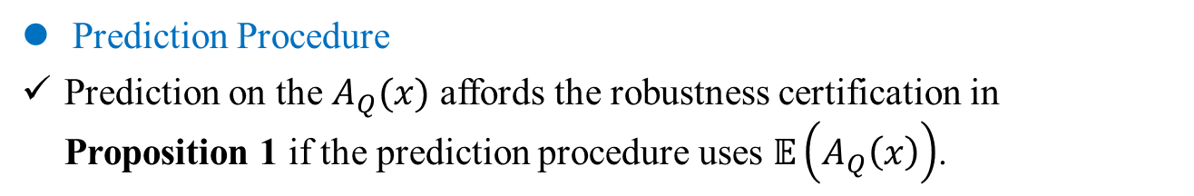
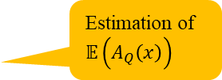
Differential Privacy
PixelDP classifier
Prediction Procedure
Prediction on the $A_{Q}(x)$ affords the robustness certification in Proposition 1 if the prediction procedure uses $𝔼\left(A_{Q}\left(x\right)\right)$.
Estimation of $𝔼\left(A_{Q}\left(x\right)\right)$
Lecuyer, Mathias. Certified robustness to adversarial examples with differential privacy. IEEE S&P 2019.
Notes:
蓝色为原始 DNN。
红色表示提供 (, δ)-DP 保证的噪声层。
噪声可以添加到输入或任何以下层，但分布由噪声层之前的每一层执行的计算的灵敏度 Δp,q 重新调整。
DNN 使用原始损失和优化器（例如 Momentum 随机梯度下降）进行训练。
预测反复调用 (, δ)-DP DNN 来衡量其对分数的经验期望

Slide 18
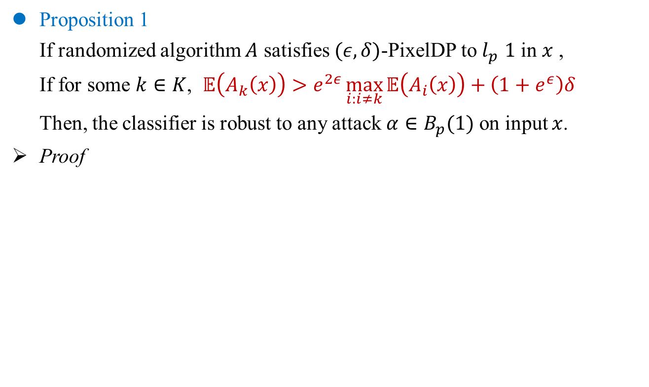
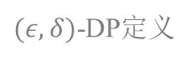
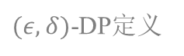
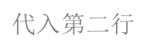
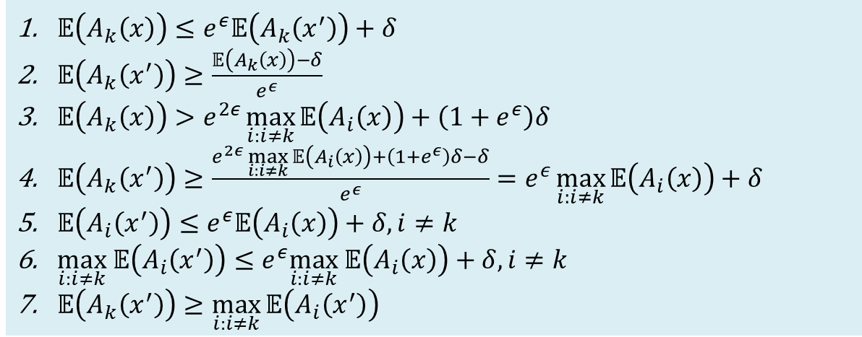
Differential Privacy
PixelDP classifier
Proposition 1
If randomized algorithm $A$ satisfies $(ε,δ)$-PixelDP to $l_{p}$ $1$ in $x$ ,
If for some $k∈K$, $𝔼\left(A_{k}\left(x\right)\right)>e^{2ε}\max_{i:i≠k}{𝔼\left(A_{i}\left(x\right)\right)}+\left(1+e^{ε}\right)δ$
Then, the classifier is robust to any attack $α∈B_{p}(1)$ on input $x$.
Proof
$𝔼\left(A_{k}\left(x\right)\right)≤e^{ε}𝔼\left(A_{k}\left(x^{′}\right)\right)+δ$
$𝔼\left(A_{k}\left(x^{′}\right)\right)≥\frac{𝔼\left(A_{k}\left(x\right)\right)−δ}{e^{ε}}$
$𝔼\left(A_{k}\left(x\right)\right)>e^{2ε}\max_{i:i≠k}{𝔼\left(A_{i}\left(x\right)\right)}+\left(1+e^{ε}\right)δ$
$𝔼\left(A_{k}\left(x^{′}\right)\right)≥\frac{e^{2ε}\max_{i:i≠k}{𝔼\left(A_{i}\left(x\right)\right)}+\left(1+e^{ε}\right)δ−δ}{e^{ε}}=e^{ε}\max_{i:i≠k}{𝔼\left(A_{i}\left(x\right)\right)}+δ$
$𝔼\left(A_{i}\left(x^{′}\right)\right)≤e^{ε}𝔼\left(A_{i}\left(x\right)\right)+δ,i≠k$
$\max_{i:i≠k} 𝔼\left(A_{i}\left(x^{′}\right)\right)≤e^{ε}\max_{i:i≠k} 𝔼\left(A_{i}\left(x\right)\right)+δ,i≠k$
$𝔼\left(A_{k}\left(x^{′}\right)\right)≥\max_{i:i≠k}{𝔼\left(A_{i}\left(x^{′}\right)\right)}$
$(ε,δ)$-DP定义
移项
假设条件
$代入$第二行
$(ε,δ)$-DP定义
两边求最大值
代入第四行
Lecuyer, Mathias. Certified robustness to adversarial examples with differential privacy. IEEE S&P 2019.
Notes:
蓝色为原始 DNN。
红色表示提供 (, δ)-DP 保证的噪声层。
噪声可以添加到输入或任何以下层，但分布由噪声层之前的每一层执行的计算的灵敏度 Δp,q 重新调整。
DNN 使用原始损失和优化器（例如 Momentum 随机梯度下降）进行训练。
预测反复调用 (, δ)-DP DNN 来衡量其对分数的经验期望

Slide 19
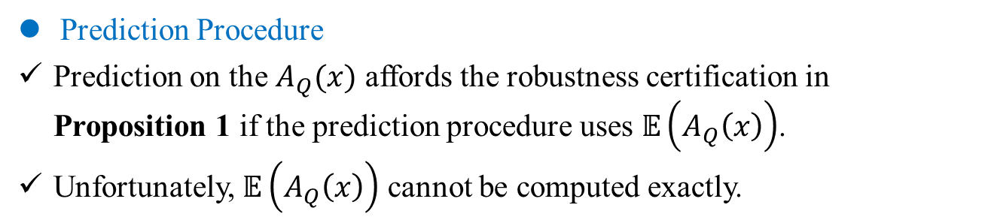
Differential Privacy
PixelDP classifier
Prediction Procedure
Prediction on the $A_{Q}(x)$ affords the robustness certification in Proposition 1 if the prediction procedure uses $𝔼\left(A_{Q}\left(x\right)\right)$.
Unfortunately, $𝔼\left(A_{Q}\left(x\right)\right)$ cannot be computed exactly.
Lecuyer, Mathias. Certified robustness to adversarial examples with differential privacy. IEEE S&P 2019.
Notes:
蓝色为原始 DNN。
红色表示提供 (, δ)-DP 保证的噪声层。
噪声可以添加到输入或任何以下层，但分布由噪声层之前的每一层执行的计算的灵敏度 Δp,q 重新调整。
DNN 使用原始损失和优化器（例如 Momentum 随机梯度下降）进行训练。
预测反复调用 (, δ)-DP DNN 来衡量其对分数的经验期望

Slide 20
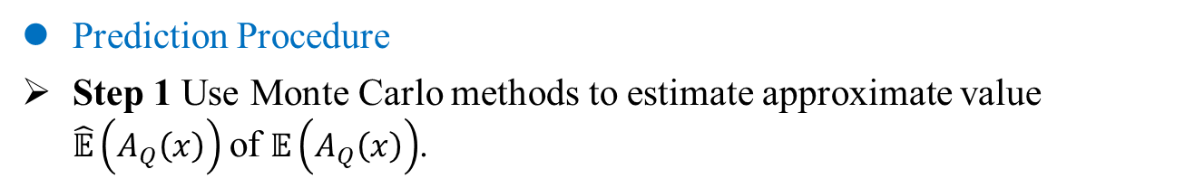
Differential Privacy
PixelDP classifier
Prediction Procedure
Step 1 Use Monte Carlo methods to estimate approximate value $\hat{𝔼}\left(A_{Q}\left(x\right)\right)$of $𝔼\left(A_{Q}\left(x\right)\right)$.
Estimation of $𝔼\left(A_{Q}\left(x\right)\right)$
Lecuyer, Mathias. Certified robustness to adversarial examples with differential privacy. IEEE S&P 2019.
Notes:
蓝色为原始 DNN。
红色表示提供 (, δ)-DP 保证的噪声层。
噪声可以添加到输入或任何以下层，但分布由噪声层之前的每一层执行的计算的灵敏度 Δp,q 重新调整。
DNN 使用原始损失和优化器（例如 Momentum 随机梯度下降）进行训练。
预测反复调用 (, δ)-DP DNN 来衡量其对分数的经验期望

Slide 21
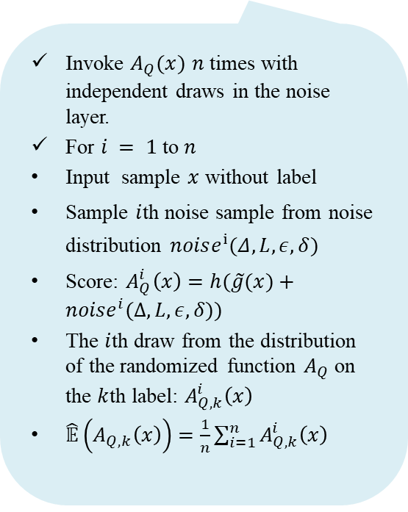
Differential Privacy
PixelDP classifier
Prediction Procedure
Step 1 Use Monte Carlo methods to estimate approximate value $\hat{𝔼}\left(A_{Q}\left(x\right)\right)$of $𝔼\left(A_{Q}\left(x\right)\right)$.
Invoke $A_{Q}(x)$ $n$ times with independent draws in the noise layer.
For $i = 1$to$n$
Input sample $x$ without label
Sample $i$th noise sample from noise distribution $noise^{i}(Δ, L, ε, δ)$
Score: $A_{Q}^{i}\left(x\right)=h(\tilde{g}(x)+noise^{i}(Δ, L, ε, δ))$
The $i$th draw from the distribution of the randomized function $A_{Q}$ on the $k$th label: $A_{Q,k}^{i}\left(x\right)$
$\hat{𝔼}\left(A_{Q,k}\left(x\right)\right)=\frac{1}{n}\sum_{i=1}^{n}{A_{Q,k}^{i}\left(x\right)}$
Estimation of $𝔼\left(A_{Q}\left(x\right)\right)$
Lecuyer, Mathias. Certified robustness to adversarial examples with differential privacy. IEEE S&P 2019.
Notes:
蓝色为原始 DNN。
红色表示提供 (, δ)-DP 保证的噪声层。
噪声可以添加到输入或任何以下层，但分布由噪声层之前的每一层执行的计算的灵敏度 Δp,q 重新调整。
DNN 使用原始损失和优化器（例如 Momentum 随机梯度下降）进行训练。
预测反复调用 (, δ)-DP DNN 来衡量其对分数的经验期望

Slide 22
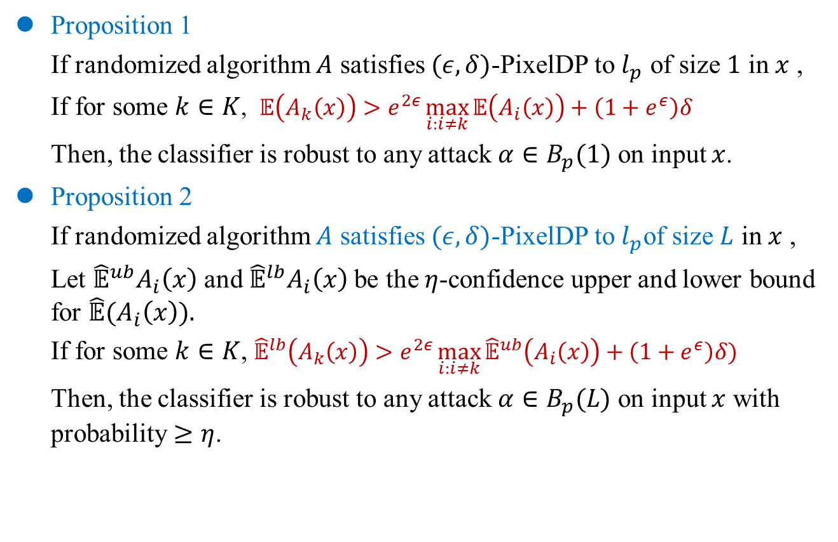
Differential Privacy
PixelDP classifier
Proposition 1
If randomized algorithm $A$ satisfies $(ε,δ)$-PixelDP to $l_{p}$ of size $1$ in $x$ ,
If for some $k∈K$, $𝔼\left(A_{k}\left(x\right)\right)>e^{2ε}\max_{i:i≠k}{𝔼\left(A_{i}\left(x\right)\right)}+\left(1+e^{ε}\right)δ$
Then, the classifier is robust to any attack $α∈B_{p}(1)$ on input $x$.
Proposition 2
If randomized algorithm $A$ satisfies $(ε,δ)$-PixelDP to $l_{p}$of size $L$ in $x$ ,
Let ${\hat{𝔼}}^{ub}A_{i}\left(x\right)$ and ${\hat{𝔼}}^{lb}A_{i}\left(x\right)$be the $η$-confidence upper and lower bound for $\hat{𝔼}(A_{i}\left(x\right)).$
If for some $k∈K$, ${\hat{𝔼}}^{lb}\left(A_{k}\left(x\right)\right)>e^{2ε}\max_{i:i≠k}{{\hat{𝔼}}^{ub}\left(A_{i}\left(x\right)\right)}+\left(1+e^{ε}\right)δ)$
Then, the classifier is robust to any attack $α∈B_{p}(L)$ on input $x$ with probability $≥η$.
Lecuyer, Mathias. Certified robustness to adversarial examples with differential privacy. IEEE S&P 2019.
Notes:
蓝色为原始 DNN。
红色表示提供 (, δ)-DP 保证的噪声层。
噪声可以添加到输入或任何以下层，但分布由噪声层之前的每一层执行的计算的灵敏度 Δp,q 重新调整。
DNN 使用原始损失和优化器（例如 Momentum 随机梯度下降）进行训练。
预测反复调用 (, δ)-DP DNN 来衡量其对分数的经验期望

Slide 23





Differential Privacy
PixelDP classifier
Proposition 2
If for some $k∈K$, ${\hat{𝔼}}^{lb}\left(A_{k}\left(x\right)\right)>e^{2ε}\max_{i:i≠k}{{\hat{𝔼}}^{ub}\left(A_{i}\left(x\right)\right)}+\left(1+e^{ε}\right)δ)$
Then, the classifier is robust to $α∈B_{p}(L)$ on $x$ with probability $≥η$.
Proof
$\hat{𝔼}\left(A_{k}\left(x\right)\right)≤e^{ε}\hat{𝔼}\left(A_{k}\left(x^{′}\right)\right)+δ$
$\hat{𝔼}\left(A_{k}\left(x^{′}\right)\right)≥\frac{\hat{𝔼}\left(A_{k}\left(x\right)\right)−δ}{e^{ε}}≥\frac{{\hat{𝔼}}^{lb}\left(A_{k}\left(x\right)\right)−δ}{e^{ε}}$
${\hat{𝔼}}^{lb}\left(A_{k}\left(x\right)\right)>e^{2ε}\max_{i:i≠k}{{\hat{𝔼}}^{ub}\left(A_{i}\left(x\right)\right)}+\left(1+e^{ε}\right)δ)$
$\hat{𝔼}\left(A_{k}\left(x^{′}\right)\right)≥\frac{{\hat{𝔼}}^{lb}\left(A_{k}\left(x\right)\right)−δ}{e^{ε}}>\frac{e^{2ε}\max_{i:i≠k}{{\hat{𝔼}}^{ub}\left(A_{i}\left(x\right)\right)}+\left(1+e^{ε}\right)δ) −δ}{e^{ε}}=e^{ε}\max_{i:i≠k}{{\hat{𝔼}}^{ub}\left(A_{i}\left(x\right)\right)}+δ$
$\hat{𝔼}\left(A_{i:i≠k}\left(x^{′}\right)\right)≤e^{ε}\max_{i:i≠k} \hat{𝔼}\left(A_{i}\left(x\right)\right)+δ$
$\max{\hat{𝔼}\left(A_{i:i≠k}\left(x^{′}\right)\right)}≤e^{ε}\max_{i:i≠k} \hat{𝔼}\left(A_{i}\left(x\right)\right)+δ≤e^{ε}\max_{i:i≠k}{{\hat{𝔼}}^{ub}\left(A_{i}\left(x\right)\right)}+δ$
$\hat{𝔼}\left(A_{k}\left(x^{′}\right)\right)$ $>$ $\max{\hat{𝔼}\left(A_{i:i≠k}\left(x^{′}\right)\right)}$
$(ε,δ)$-DP定义
移项，取下届
假设条件
$代入$第二行
$(ε,δ)$-DP定义
最大值
代入第四行
Lecuyer, Mathias. Certified robustness to adversarial examples with differential privacy. IEEE S&P 2019.
Notes:
蓝色为原始 DNN。
红色表示提供 (, δ)-DP 保证的噪声层。
噪声可以添加到输入或任何以下层，但分布由噪声层之前的每一层执行的计算的灵敏度 Δp,q 重新调整。
DNN 使用原始损失和优化器（例如 Momentum 随机梯度下降）进行训练。
预测反复调用 (, δ)-DP DNN 来衡量其对分数的经验期望

Slide 24


Differential Privacy
PixelDP classifier
Prediction Procedure
Step 1 Use Monte Carlo methods to estimate approximate value $\hat{𝔼}\left(A_{Q}\left(x\right)\right)$of $𝔼\left(A_{Q}\left(x\right)\right)$.
Compute a interval $[{\hat{𝔼}}^{lb}\left(A_{Q}\left(x\right)\right),{\hat{𝔼}}^{ub}\left(A_{Q}\left(x\right)\right)]$ for $\hat{𝔼}\left(A_{Q}\left(x\right)\right)$ holds with probability $η$.
Use Hoeffding’s inequality (霍夫丁不等式) to bound error in $\hat{𝔼}\left(A_{Q}\left(x\right)\right)$.
$\hat{𝔼}\left(A_{Q}\left(x\right)\right)−\sqrt{\frac{1}{2n}\ln\left(\frac{2k}{1−n}\right)}$ $≤𝔼\left(A_{Q}\left(x\right)\right)≤\hat{𝔼}\left(A_{Q}\left(x\right)\right)+\sqrt{\frac{1}{2n}\ln\left(\frac{2k}{1−n}\right)}$
${\hat{𝔼}}^{lb}\left(A_{Q}\left(x\right)\right)≜\hat{𝔼}\left(A_{Q}\left(x\right)\right)−\sqrt{\frac{1}{2n}\ln\left(\frac{2k}{1−n}\right)}$
${\hat{𝔼}}^{ub}\left(A_{Q}\left(x\right)\right)≜\hat{𝔼}\left(A_{Q}\left(x\right)\right)+\sqrt{\frac{1}{2n}\ln\left(\frac{2k}{1−n}\right)}$
Integrate this interval into the stability bound for $𝔼\left(A_{Q}\left(x\right)\right)$.
$$𝔼\left(A_{Q}\left(x\right)\right)≤e^{ε}𝔼\left(A_{Q}\left(x+α\right)\right)+bδ$$
Estimation of $𝔼\left(A_{Q}\left(x\right)\right)$
Lecuyer, Mathias. Certified robustness to adversarial examples with differential privacy. IEEE S&P 2019.
Notes:
蓝色为原始 DNN。
红色表示提供 (, δ)-DP 保证的噪声层。
噪声可以添加到输入或任何以下层，但分布由噪声层之前的每一层执行的计算的灵敏度 Δp,q 重新调整。
DNN 使用原始损失和优化器（例如 Momentum 随机梯度下降）进行训练。
预测反复调用 (, δ)-DP DNN 来衡量其对分数的经验期望

Slide 25


Differential Privacy
PixelDP classifier
Prediction Procedure
Step 1 Use Monte Carlo methods to estimate approximate value $\hat{𝔼}\left(A_{Q}\left(x\right)\right)$of $𝔼\left(A_{Q}\left(x\right)\right)$.
Step 2 PixelDP returns a prediction for $x$ ($\arg{\max{ \hat{𝔼}\left(A_{Q}\left(x\right)\right)}}$) and a robustness size certificate for that prediction.
Obtain upper and lower bounds on the change to $\hat{𝔼}\left(A_{Q,i}\left(x\right)\right)$with input change of size $L$with probability $η$.
Compute robustness size certificate:
If,${\hat{𝔼}}^{lb}\left(A_{Q,k}\left(x\right)\right)>e^{2ε}\max_{i:i≠k}{{\hat{𝔼}}^{ub}\left(A_{Q,i}\left(x\right)\right)}+\left(1+e^{ε}\right)δ$
Then, the classifier is robust to any$α∈B_{p}(L)$ around $x$ with probability $≥η$.
Else, $x$ not meet robustness check for L.
Estimation of $𝔼\left(A_{Q}\left(x\right)\right)$
Lecuyer, Mathias. Certified robustness to adversarial examples with differential privacy. IEEE S&P 2019.
Notes:
蓝色为原始 DNN。
红色表示提供 (, δ)-DP 保证的噪声层。
噪声可以添加到输入或任何以下层，但分布由噪声层之前的每一层执行的计算的灵敏度 Δp,q 重新调整。
DNN 使用原始损失和优化器（例如 Momentum 随机梯度下降）进行训练。
预测反复调用 (, δ)-DP DNN 来衡量其对分数的经验期望

Slide 26





Differential Privacy
PixelDP classifier
${\hat{𝔼}}^{up}\left(A_{Q,i}\left(x\right)\right)$ and ${\hat{𝔼}}^{lp}\left(A_{Q,i}\left(x\right)\right)$
If the lower bound for the label with the top average score ${\hat{𝔼}}^{lb}\left(A_{Q,k}\left(x\right)\right)$is strictly greater than the upper bound for every other label $\max_{i:i≠k}{{\hat{𝔼}}^{ub}\left(A_{Q,i}\left(x\right)\right)}$,
Then, with probability $η$, the prediction for input $x$ is robust to arbitrary attacks of $l_{p}$ size $L$.
$$[{\hat{𝔼}}^{lb}\left(A_{Q}\left(x\right)\right),{\hat{𝔼}}^{ub}\left(A_{Q}\left(x\right)\right)]$$
$${\hat{𝔼}}^{ub}\left(A_{Q,k}\left(x\right)\right)$$
$${\hat{𝔼}}^{lb}\left(A_{Q,k}\left(x\right)\right)$$
鸵鸟
秃鹫
Lecuyer, Mathias. Certified robustness to adversarial examples with differential privacy. IEEE S&P 2019.
Notes:
在将经验和真实期望（绿色）与引理 1 中给定攻击规模 Lattack（红色）的稳定性界限之间的测量误差界限相加后，如果 arg 的下限，则证明预测对该攻击规模是稳健的 最大标签不与任何其他标签的上限重叠。

Slide 27

Differential Privacy
PixelDP classifier
Noise layer place
Noise in the image
${\text{Δ}}_{p,q}={\text{Δ}}_{1,1}^{g}=\max_{x,x^{′}:x≠x^{′}}{\frac{{\left|\left|g\left(x\right)−g\left(x^{′}\right)\right|\right|}_{q}}{{\left|\left|x−x^{′}\right|\right|}_{p}}}=\max_{x,x^{′}:x≠x^{′}}{\frac{{\left|\left|g\left(x\right)−g\left(x^{′}\right)\right|\right|}_{1}}{{\left|\left|x−x^{′}\right|\right|}_{1}}}$
${\text{Δ}}_{p,q}={\text{Δ}}_{2,2}^{g}=\max_{x,x^{′}:x≠x^{′}}{\frac{{\left|\left|g\left(x\right)−g\left(x^{′}\right)\right|\right|}_{q}}{{\left|\left|x−x^{′}\right|\right|}_{p}}}=\max_{x,x^{′}:x≠x^{′}}{\frac{{\left|\left|g\left(x\right)−g\left(x^{′}\right)\right|\right|}_{2}}{{\left|\left|x−x^{′}\right|\right|}_{2}}}$
Lecuyer, Mathias. Certified robustness to adversarial examples with differential privacy. IEEE S&P 2019.

Slide 28

Differential Privacy
PixelDP classifier
Noise layer place
Noise in the image
Noise after first hidden layer
$g\left(x\right)=f_{1}(x)$
${\text{Δ}}_{p,q}={\text{Δ}}_{p,q}^{g}={\text{Δ}}_{p,q}^{f_{1}}$
Lecuyer, Mathias. Certified robustness to adversarial examples with differential privacy. IEEE S&P 2019.

Slide 29

Differential Privacy
PixelDP classifier
Noise layer place
Noise in the image
Noise after first hidden layer
Noise after deeper hidden layer
$g\left(x\right)=f_{1}(f_{2}(x))$
${\text{Δ}}_{p,q}={\text{Δ}}_{p,q}^{g}={\text{Δ}}_{p,q}^{(f_{1}°f_{2})}$
Lecuyer, Mathias. Certified robustness to adversarial examples with differential privacy. IEEE S&P 2019.

Slide 30

Differential Privacy
PixelDP classifier
Noise layer place
Noise in the image
Noise after first hidden layer
Noise after deeper hidden layer
Noise in Auto-encoder
Auto-encoders are smaller than DNN, much faster to train. (ImageNet)
Lecuyer, Mathias. Certified robustness to adversarial examples with differential privacy. IEEE S&P 2019.

Slide 31
Differential Privacy
Contribution
Establish a connection between adversarial robustness and differential privacy.
Develop the first certified defense that scales to large networks (Google’s Inception network) and datasets (ImageNet).
Develop the certified defense that applies broadly to arbitrary model types.
Datasets:
ImageNet,
CIFAR10, CIFAR100, SVHN
MNIST
Networks:
Inception
ResNet
Lecuyer, Mathias. Certified robustness to adversarial examples with differential privacy. IEEE S&P 2019.
Notes:
差分隐私，一种受密码学启发的隐私形式主义，为防御提供了严格、通用和灵活的基础。
数据中的微小变化会导致有界的输出变化。

Slide 32





Differential Privacy
Authors
Mathias Lecuyer
PhD
Columbia University
Vaggelis Atlidakis
PhD
Columbia University
Roxana Geambasu
Associate Professor
Columbia University
Daniel Hsu
associate professor
Columbia University
Suman Jana
associate professor
Columbia University
Lecuyer, Mathias. Certified robustness to adversarial examples with differential privacy. IEEE S&P 2019.

Slide 33

Certified Adversarial Robustness via Randomized Smoothing
Jeremy Cohen, Elan Rosenfeld, J. Zico Kolter
Carnegie Mellon University
ICML 2019

Slide 34



Randomized Smoothing
Overview
Applying Gaussian noise and taking majority class label.
Essence: Smoothing the decision boundary of the base classifier $f$.
Way: Sampling Gaussian noise to perturb $x$ multiple times, then vote on the labels most frequently given by the base classifier $f$.
Purpose: Output the majority class label as the prediction of $x$.
$$x$$
Decision boundary of base classifier $f$
Cohen, Jeremy, Elan Rosenfeld, and Zico Kolter. Certified adversarial robustness via randomized smoothing. ICML 2019.

Slide 35

Randomized Smoothing
Overview
Applying Gaussian noise and taking majority class label.
Essence: Smoothing the decision boundary of the base classifier $f$.
Way: Sampling Gaussian noise to perturb $x$ multiple times, then vote on the labels most frequently given by the base classifier $f$.
Purpose: Output the majority class label as the prediction of $x$.
$$x$$
Decision boundary of base classifier $f$
Cohen, Jeremy, Elan Rosenfeld, and Zico Kolter. Certified adversarial robustness via randomized smoothing. ICML 2019.

Slide 36
Randomized Smoothing
Overview
Applying Gaussian noise and taking majority class label.
Essence: Smoothing the decision boundary of the base classifier $f$.
Way: Sampling Gaussian noise to perturb $x$ multiple times, then vote on the labels most frequently given by the base classifier $f$.
Purpose: Output the majority class label as the prediction of $x$.
$$x$$
Decision boundary of base classifier $f$
Cohen, Jeremy, Elan Rosenfeld, and Zico Kolter. Certified adversarial robustness via randomized smoothing. ICML 2019.

Slide 37

Randomized Smoothing
Overview
Applying Gaussian noise and taking majority class label.
Essence: Smoothing the decision boundary of the base classifier $f$.
Way: Sampling Gaussian noise to perturb $x$ multiple times, then vote on the labels most frequently given by the base classifier $f$.
Purpose: Output the majority class label as the prediction of $x$.
$$x$$
Decision boundary of smoothed classifier $g$
Cohen, Jeremy, Elan Rosenfeld, and Zico Kolter. Certified adversarial robustness via randomized smoothing. ICML 2019.

Slide 38








Randomized Smoothing
Overview
Evaluating the smoothed classifier at an input $x$.
Smoothed classifier $g$: a virtual classifier with smoother boundary than $f$
Here, $g\left(x\right)=C_{A}$.
$$C_{B}$$
$$C_{C}$$
$$C_{D}$$
$$C_{A}$$
Left:
Colors: decision regions of $f$.
Dotted lines: level sets of $N (x, σ^{2}I)$.
$N (x, σ^{2}I)$
Figure 1
Cohen, Jeremy, Elan Rosenfeld, and Zico Kolter. Certified adversarial robustness via randomized smoothing. ICML 2019.

Slide 39

Randomized Smoothing
Problem
Randomized smoothing-based heuristic defense
Method
Insert noise layer before each convolution layer. (Liu. ECCV 2018)
Ensemble information in a region centered at $x$ to predict.(Cao. ACSAC2017)
Problem: did not prove any guarantees.
Randomized smoothing-based certified defense
Methods
Smooth the classifier with noise and use DP inequalities to prove robustness guarantee. (Lecuyer. IEEE S&P 2019)
Use Renyi divergence to prove a stronger guarantee. (Li. arXiv2018)
Problem: existing robustness guarantees are loose.
Liu, Xuanqing. Towards robust neural networks via random self-ensemble. ECCV 2018.
Cao, Xiaoyu. Mitigating evasion attacks to deep neural networks via region-based classification. ACSAC2017.
Lecuyer, Mathias. Certified robustness to adversarial examples with differential privacy. IEEE S&P 2019.
Li, Bai, et al. "Second-order adversarial attack and certifiable robustness." arXiv2018.

Slide 40

Randomized Smoothing
Problem
Advantage of randomized smoothing
Makes no assumptions about classifier architecture.
Permits to use arbitrarily large neural networks. (others do not support)
The only certified defense been shown feasible on ImageNet task. (before this work)
Challenge of randomized smoothing
Not possible to exactly compute the probabilities with which $f$ classifies $𝒩(x,σ^{2}I)$as each class.
Not possible to exactly evaluate the smoothed classifier 𝑔
Not possible to exactly compute the radius in which 𝑔 is robust.
Solution
Use Monte Carlo method to evaluate prediction of the classifier around 𝑥.
Cohen, Jeremy, Elan Rosenfeld, and Zico Kolter. Certified adversarial robustness via randomized smoothing. ICML 2019.

Slide 41

Randomized Smoothing
Notation
Symbol | Definition
$$𝒴$$ | Classes set
$$g$$ | Random smoothed classifier
$$f:ℝ^{d}→𝒴$$ | Base classifier
$$x∈ℝ^{d}$$ | Input space
$$ε\sim N(0,σ^{2}I)$$ | Isotropic Gaussian noise
$$C_{A}∈𝒴$$ | most probable class returned by $f(x+ε)$
$$p_{A}∈[0,1]$$ | $ℙ(f\left(x+ε\right)=C_{A})$.
$$C_{B}$$ | “runner-up” class returned by $f(x+ε)$
$$p_{B}∈[0,1]$$ | $ℙ(f\left(x+ε\right)=C_{B})$.
$$\underline{p_{A}}∈[0,1]$$ | lower bound of $p_{A}$
$$\overline{p_{B}}∈[0,1]$$ | upper bound of $p_{B}$
$$δ=(δ_{1},δ_{2},…,δ_{n})$$ | $n$-dimensional perturbation
$${||δ||}_{2}$$ | 2 norm of the vector $δ$ , $\sqrt{({δ_{1}}^{2}+{δ_{2}}^{2}+…+{δ_{n}}^{2})}$
Cohen, Jeremy, Elan Rosenfeld, and Zico Kolter. Certified adversarial robustness via randomized smoothing. ICML 2019.

Slide 42




Randomized Smoothing
Algorithm
Smoothed Classifier $g$
Definition:
Smoothed classifier $g$ returns whichever class the base classifier $f$ is most likely to return when $x$ is perturbed by isotropic Gaussian noise:
Interpretation:
Randomized smoothing in high dimension is that these large random perturbations 𝜀 drown out small adversarial perturbations 𝛿.
$g\left(x\right)=\underset{c∈𝒴 }{arg max}{ℙ(f\left(x+ε\right)=c)}$ (1)
Where $ε\sim N(0,σ^{2})$
random Gaussian corruptions of $x$ ($σ = 0.5$)
Lecuyer Mathias. Certified robustness to adversarial examples with differential privacy. IEEE S&P 2019.
Notes:
数学期望是试验中每次可能结果的概率乘以其结果的总和，

Slide 43

Randomized Smoothing
Algorithm
Smoothed Classifier $g$
Definition:
Smoothed classifier $g$ returns whichever class the base classifier $f$ is most likely to return when $x$ is perturbed by isotropic Gaussian noise:
Base classifier $f$
In order for $g$ to classify the labeled example $(x, c)$correctly and robustly, $f$ needs to consistently classify $N(x,σ^{2}I)$as $c$ at training.
Train $f$with Gaussian data augmentation at variance $σ^{2}$, with training noise level $σ_{train}≥σ_{pred}$ prediction noise level .
$g\left(x\right)=\underset{c∈𝒴 }{arg max}{ℙ(f\left(x+ε\right)=c)}$ (1)
Where $ε\sim N(0,σ^{2})$
Lecuyer Mathias. Certified robustness to adversarial examples with differential privacy. IEEE S&P 2019.
Notes:
数学期望是试验中每次可能结果的概率乘以其结果的总和，

Slide 44


Randomized Smoothing
Algorithm
How much noise to use when training the base classifier ?
Holding prediction noise level fixed at $σ_{pred}$= 0.5 .
If $f$ was trained with a different noise level ($σ_{train}≠$ 0.5), $g$ has lower certified accuracy. (blue and green)
It is better to train with $σ_{train}$ $>σ_{pred}$ than to train with $σ_{train}$ $<σ_{pred}$.
(a) CIFAR-10
Figure 15
(b) ImageNet
Cohen, Jeremy, Elan Rosenfeld, and Zico Kolter. Certified adversarial robustness via randomized smoothing. ICML 2019.

Slide 45



Randomized Smoothing
Algorithm
Independent algorithms for the two tasks:
(A) Evaluating $g(x)$
(B) Evaluating and certifying $g(x)$
PREDICT$(f, σ, x, n, α)$
CERTIFY$(f, σ, x, n_{0}, n, α)$
1
2
3
Cohen, Jeremy, Elan Rosenfeld, and Zico Kolter. Certified adversarial robustness via randomized smoothing. ICML 2019.

Slide 46

Randomized Smoothing
Algorithm
PREDICT$(f, σ, x, n, α)$
Requirement:
Only need to identify the class $c_{A}$ with maximal weight in $f(x+ε)$
1
2
Cohen, Jeremy, Elan Rosenfeld, and Zico Kolter. Certified adversarial robustness via randomized smoothing. ICML 2019.

Slide 47


Randomized Smoothing
Algorithm
PREDICT$(f, σ, x, n, α)$
SampleUnderNoise $(f, x, n, σ)$
Draw $n$ samples of noise:
$$ε_{1}, ε_{2},…, ε_{n}∼N(0; σ^{2}I).$$
Run noisy images through the base classifier$f$ to obtain the predictions:
$$f\left(x+ε_{1}\right),f\left(x+ε_{2}\right),…,f(x+ε_{n})$$
Return the $counts$ for each class, where the $count$ for class $c$ is defined as:
$$\sum_{i=1}^{n}{1[if f(x+ε_{i})=c]}$$
$$n_{A}=\sum_{i=1}^{n}{1[if f(x+ε_{i})=c_{A}]}$$
$$n_{B}=\sum_{i=1}^{n}{1[if f(x+ε_{i})=c_{B}]}$$
1
2
Cohen, Jeremy, Elan Rosenfeld, and Zico Kolter. Certified adversarial robustness via randomized smoothing. ICML 2019.

Slide 48



Randomized Smoothing
Algorithm
PREDICT$(f, σ, x, n, α)$
1
BinomPValue $(n_{A}, n_{A}+n_{B}, p=0.5)$
Return the p-value of the two-sided hypothesis test that $n_{A}∼ Binomial(n_{A}+n_{B},p=0.5)$.
P-value: probability of obtaining very unlikely observations when assuming null hypothesis is correct.
Two-sided hypothesis test:
P-$value=2∗$P-$value_{right}$
When α is small, abstains frequently, but rarely returns wrong class.
When α is large, seldom abstains, but often return the wrong class.
2
Hung, Kenneth, William Fithian. "Rank verification for exponential families." The Annals of Statistics 47.2 (2019): 758-782.
Notes:
$n_{A}$服从二项分布Binomial($n_{A}+n_{B};p$)，表示做（$n_{A}+n_{B}$）次独立重复的伯努利试验，每次事件A (被预测为$c_{A}$) 发生的概率为$p$. （$n_{A}+n_{B}$)次实验中，事件A (被预测为$c_{A}$) 发生的总次数计为随机变量$n_{A}$。那么，$n_{A}$服从参数为$n_{A}+n_{B}和p$的二项分布.
P值：原假设为真时取到极端情况的概率
双边假设检验P值：如果是双侧检验,其p值通常是在单侧的基础上乘以2。
scipy.stats 模块包含大量概率分布、频率统计、统计检验、核密度估计、准蒙特卡洛等函数接口。scipy.stats.binom_test 是python的数学工具库 scipy 下的统计模块 scipy.stats 中的一项函数。是对伯努利实验中成功概率为$p$的原假设的精确双边检验。

Slide 49





Randomized Smoothing
Algorithm
CERTIFY$(f, σ, x, n_{0}, n, α)$
Requirement:
Identify the class $c_{A}$ with maximal weight in $f(x+ε)$
Estimate a lower bound $\underline{p_{A}}$ on $p_{A}≔P(f\left(x+ε\right)=c_{A})$
Estimate an upper bound $\overline{p_{B}}$ on $p_{B}≔\max_{c≠c_{A}}{P(f\left(x+ε\right)=c)}$
Problem
Statistically speaking, estimating $\underline{p_{A}}$ and $\overline{p_{B}}$ while simultaneously identifying the top class $c_{A}$ is a little bit tricky.
Solution
Two-step procedure
$$C_{A}$$
$$C_{B}$$
$$C_{C}$$
$$C_{D}$$
Cohen, Jeremy, Elan Rosenfeld, and Zico Kolter. Certified adversarial robustness via randomized smoothing. ICML 2019.

Slide 50

Randomized Smoothing
Algorithm
CERTIFY$(f, σ, x, n_{0}, n, α)$
Requirement:
Identify the class $c_{A}$ with maximal weight in $f(x+ε)$
Estimate a lower bound $\underline{p_{A}}$ on $p_{A}≔P(f\left(x+ε\right)=c_{A})$
Estimate an upper bound $\overline{p_{B}}$ on $p_{B}≔\max_{c≠c_{A}}{P(f\left(x+ε\right)=c)}$
Procedure:
3
Cohen, Jeremy, Elan Rosenfeld, and Zico Kolter. Certified adversarial robustness via randomized smoothing. ICML 2019.

Slide 51

Randomized Smoothing
Algorithm
CERTIFY$(f, σ, x, n_{0}, n, α)$
Requirement:
Identify the class $c_{A}$ with maximal weight in $f(x+ε)$
Estimate a lower bound $\underline{p_{A}}$ on $p_{A}≔P(f\left(x+ε\right)=c_{A})$
Estimate an upper bound $\overline{p_{B}}$ on $p_{B}≔\max_{c≠c_{A}}{P(f\left(x+ε\right)=c)}$
Procedure:
Use a small number $n_{0}$ of samples from $f\left(x+ε\right)$ to take a guess at $c_{A}$, because $f\left(x+ε\right)$ tends to put most of its weight on the top class,
3
Cohen, Jeremy, Elan Rosenfeld, and Zico Kolter. Certified adversarial robustness via randomized smoothing. ICML 2019.

Slide 52

Randomized Smoothing
Algorithm
CERTIFY$(f, σ, x, n_{0}, n, α)$
Requirement:
Identify the class $c_{A}$ with maximal weight in $f(x+ε)$
Estimate a lower bound $\underline{p_{A}}$ on $p_{A}≔P(f\left(x+ε\right)=c_{A})$
Estimate an upper bound $\overline{p_{B}}$ on $p_{B}≔\max_{c≠c_{A}}{P(f\left(x+ε\right)=c)}$
Procedure:
Use a larger number $n$ of samples to estimate $\underline{p_{A}}$ and $\overline{p_{B}}$
Use LowerConfBound $\left(k, n, 1−α\right)$ to return $\underline{p_{A}}$ of $[\underline{p_{A}},\overline{p_{A}}]$ that holds with probability at least 1−α over the sampling of $k∼ Binomial\left(n,p_{A}\right)\text{.}$
Clopper-Person confidence interval (二项式比例置信区间): 根据一系列伯努利成功($c_{A}$)-失败($c_{B}$)实验的结果计算出的成功($c_{A}$)概率($p_{A}$)的置信区间$[\underline{p_{A}},\overline{p_{A}}]$
Take $\underline{p_{B}}$ = 1 − $\underline{p_{A}}$.
3
Cohen, Jeremy, Elan Rosenfeld, and Zico Kolter. Certified adversarial robustness via randomized smoothing. ICML 2019.
Notes:
$k∼Binomial\left(n;p\right)$分布表明：执行n次预测，其中k次分类为cA, 每次实验预测为cA的概率是p.
未被分配给CA的概率更有可能完全被分给CB，而不是平均的分给所有其它类别

Slide 53

Randomized Smoothing
Algorithm
CERTIFY$(f, σ, x, n_{0}, n, α)$
Requirement:
Identify the class $c_{A}$ with maximal weight in $f(x+ε)$
Estimate a lower bound $\underline{p_{A}}$ on $p_{A}≔P(f\left(x+ε\right)=c_{A})$
Estimate an upper bound $\overline{p_{B}}$ on $p_{B}≔\max_{c≠c_{A}}{P(f\left(x+ε\right)=c)}$
Procedure:
If $\underline{p_{A}}>0.5$ (即 $\overline{p_{B}}<0.5$ )
Compute robustness guarantee
$$R=\frac{σ}{2}\left(φ^{−1}\left(\underline{p_{A}}\right)−φ^{−1}(\overline{p_{B}})\right)=\frac{σ}{2}\left(φ^{−1}\left(\underline{p_{A}}\right)−φ^{−1}(1−\underline{p_{A}})\right)=\frac{σ}{2}∙2φ^{−1}\left(\underline{p_{A}}\right)=σφ^{−1}(\underline{p_{A}})$$
Return $\hat{c_{A}}$and $R$
3
Cohen, Jeremy, Elan Rosenfeld, and Zico Kolter. Certified adversarial robustness via randomized smoothing. ICML 2019.

Slide 54


Randomized Smoothing
Radius
证明
要证 $g\left(x+δ\right)=\underset{c∈𝒴 }{arg max}{ℙ(f\left(x+ε+δ\right)=c)}=c_{A}$
就要证 $ℙ\left(f\left(x+ε+δ\right)=c_{A}\right)>\max_{c≠c_{A}}{ℙ(f\left(x+ε+δ\right)=c)}$
对任意$c_{B}≠c_{A}$, 证 $ℙ\left(f\left(x+ε+δ\right)=c_{A}\right)>ℙ(f\left(x+ε+δ\right)=c_{B})$
Cohen, Jeremy, Elan Rosenfeld, and Zico Kolter. Certified adversarial robustness via randomized smoothing. ICML 2019.

Slide 55













Randomized Smoothing
Radius
Illustration of the proof of Theorem 1.
当且仅当 $ℙ\left(f\left(Y∈A\right)\right)>ℙ\left(f\left(Y∈B\right)\right)$成立，有$ℙ\left(f\left(x+ε+δ\right)=c_{A}\right)>ℙ(f\left(x+ε+δ\right)=c_{B})$
定义：$A≔\{z:δ^{T}\left(z−x\right)≤σ\left|\left|δ\right|\right|φ^{−1}(\underline{p_{A}})\}$ $B≔\{z:δ^{T}\left(z−x\right)≤σ\left|\left|δ\right|\right|φ^{−1}(\overline{p_{B}})\}$
$ℙ\left(f\left(Y∈A\right)\right)=φ(φ^{−1}\left(\underline{p_{A}}\right)−\frac{\left|\left|δ\right|\right|}{σ})$ $ℙ\left(f\left(Y∈B\right)\right)=φ(φ^{−1}\left(\overline{p_{B}}\right)+\frac{\left|\left|δ\right|\right|}{σ})$
set $B$
set $B$
The figure on the left depicts a situation where $ℙ(Y∈A) >ℙ(Y∈B)$, and hence $g\left(x+δ\right)=g(Y)$ may equal $c_{A}$.
The figure on the right depicts a situation where where $ℙ\left(Y∈A\right)<ℙ\left(Y∈B\right)$ and hence $g\left(x+δ\right)=g(Y)≠c_{A}$.
$$Y:=x+δ+ε$$
$$Y$$
level sets of $Y$
$$X$$
$$X:=x+ε$$
level sets of $X$
set $A$
set $A$
Figure 9
Cohen, Jeremy, Elan Rosenfeld, and Zico Kolter. Certified adversarial robustness via randomized smoothing. ICML 2019.

Slide 56

Randomized Smoothing
Evaluation
Metric of normal classification
Standard test set accuracy: $STD.ACC=\frac{N_{g−Correctly}}{N_{g−Total}}$
Metric of certified classification
Certified test set accuracy at radius $r$:
$CERT.ACC=\frac{N_{g−Correctly−Robust}}{N_{g−Total}}$
$g$ classifies correctly (without abstaining) and certifies robust with a radius $R≥r$.
$r$ is similar toThreshold size $T$ defined in Lecuyer. IEEE S&P 2019.
Cohen, Jeremy, Elan Rosenfeld, and Zico Kolter. Certified adversarial robustness via randomized smoothing. ICML 2019.

Slide 57






Randomized Smoothing
Evaluation
Experiments with randomized smoothing on ImageNet with σ = 0.25.
Left: certified accuracies obtained using CERTIFY VS. those obtained using the guarantees derived in prior works (SP2019).
Middle: certified accuracy if the number of samples $n$ used by CERTIFY had been larger or smaller.
Right: certified accuracy as the failure probability $α$ of CERTIFY is varied.
$$α=0.000001$$
$$α=0.0001$$
higher certified accuracies
$$α=0.01$$
larger $n$, larger $R$
certified accuracy is not sensitive to α
Figure 8
Lecuyer, M. Certified robustness to adversarial examples with differential privacy. SP, 2019
Notes:
图 8（左）绘制了使用我们的定理 1 保证获得的认证准确度以及使用 Lecuyer 等人的类似界限获得的认证准确度。 （2019）和李等人。 （2018 年）。由于我们对认证半径 R 的表达式更大（实际上更紧密），我们的界限提供了更高的认证精度。 图 8（中）预测了如果 CERTIFY 使用更多或更少的样本 n（假设计数中的相对类别比例保持不变），认证准确度将如何变化。最后，图 8（右）绘制了随着置信度参数 α 变化的认证准确度。 请注意，经认证的精度对 α 不是很敏感。

Slide 58



Differential Privacy
Contribution
Prove the first tight robustness guarantee for randomized smoothing.
Analysis reveals that smoothing with Gaussian noise naturally induces certifiable robustness under the $l_{2}$ norm.
Suspect that other noise distributions might induce robustness to other perturbation sets such as general $l_{p}$ norm balls.
Enables the use of large networks on large scale datasets and does not constrain the architecture of the classifier.
Datasets:
ImageNet
CIFAR10
Networks:
ResNet
CIFAR10
ImageNet
Lecuyer, Mathias. Certified robustness to adversarial examples with differential privacy. IEEE S&P 2019.
Notes:
差分隐私，一种受密码学启发的隐私形式主义，为防御提供了严格、通用和灵活的基础。
数据中的微小变化会导致有界的输出变化。

Slide 59




Randomized Smoothing
Authors
Jeremy Cohen
PhD at CMU
Elan Rosenfeld
PhD at CMU
J. Zico Kolter
Associate Professor at CMU
Cohen, Jeremy, Elan Rosenfeld, and Zico Kolter. Certified adversarial robustness via randomized smoothing. ICML 2019.

Slide 60
Evaluation of Differential Privacy

Slide 61

Differential Privacy
Evaluation
Metrics
Conventional (Standard) accuracy: $\frac{\sum_{i=1}^{n}{isCorrect\left(x_{i}\right)}}{n}$
Testing samples number: $n$
If the prediction on $x_{i}$ returns the correct label, $isCorrect(x_{i}$) returns $1$.
Certified accuracy: $\frac{\sum_{i=1}^{n}{isCorrect\left(x_{i}\right) \& robustSize(scores,ε,δ,L)≥T}}{n}$
$robustSize(scores,ε,δ,L)$returns the certified robustness size.
Threshold size $T$: a parameter at inference that can differ from L, that is used to configure the standard deviation of the DP noise.
Precision on certified examples: $\frac{\sum_{i=1}^{n}{isCorrect\left(x_{i}\right) \& robustSize(p_{i},ε,δ,L)≥T}}{\sum_{i=1}^{n}{robustSize\left(p_{i},ε,δ,L\right)≥T}}$
Lecuyer, Mathias. Certified robustness to adversarial examples with differential privacy. IEEE S&P 2019.

Slide 62

Differential Privacy
PixelDP classifier
Prediction Procedure
Step 1 Use Monte Carlo methods to estimate approximate value $\hat{𝔼}\left(A_{Q}\left(x\right)\right)$of $𝔼\left(A_{Q}\left(x\right)\right)$.
Step 2 PixelDP returns a prediction for $x$ ($\arg{\max{ \hat{𝔼}\left(A_{Q}\left(x\right)\right)}}$) and a robustness size certificate for that prediction.
Maximum certificate size $L_{max}⁡$: no attack within $L_{max}⁡$will be able to change the highest probability.
Compute $L_{max}$
Given $σ$ that grows in $\frac{Δ_{p,q}L}{ε}$,
$L_{max} =\max_{L∈R^{+}}{L}$such that
${\hat{𝔼}}^{lb}\left(A_{k}\left(x\right)\right)>e^{2ε}\max_{i:i≠k}{{\hat{𝔼}}^{ub}\left(A_{i}\left(x\right)\right)}+\left(1+e^{ε}\right)δ)$
For Gaussian,
$σ=\sqrt{2\ln\left(\frac{1.25}{δ}\right)}∙{\text{Δ}}_{p,2}∙\frac{L}{ε}$ , $ε≤1$
For Laplace，$σ={\text{Δ}}_{p,1}∙\frac{L}{ε}$
Estimation of $𝔼\left(A_{Q}\left(x\right)\right)$
Lecuyer, Mathias. Certified robustness to adversarial examples with differential privacy. IEEE S&P 2019.
Notes:
蓝色为原始 DNN。
红色表示提供 (, δ)-DP 保证的噪声层。
噪声可以添加到输入或任何以下层，但分布由噪声层之前的每一层执行的计算的灵敏度 Δp,q 重新调整。
DNN 使用原始损失和优化器（例如 Momentum 随机梯度下降）进行训练。
预测反复调用 (, δ)-DP DNN 来衡量其对分数的经验期望

Slide 63

Differential Privacy
Evaluation
Conventional accuracy of baseline models.
Last column shows the accuracy of the baseline undefended models.
complexity
Table I
Lecuyer, Mathias. Certified robustness to adversarial examples with differential privacy. IEEE S&P 2019.
Notes:
最后一列显示了基线、无防御模型的准确性。 数据集根据规模或复杂性的降序排序

Slide 64


Differential Privacy
Evaluation
Configurations
We implement defenses for different $l_{p}$ attack and noise distribution.
Autoencoder:
The encoder has 3 convolutional layers and tied encoder/decoder weights.
Add the DP noise after the first convolution layer.
Table II
Lecuyer, Mathias. Certified robustness to adversarial examples with differential privacy. IEEE S&P 2019.
Notes:
更高分辨率的图像可以在其类别区分内容被破坏之前容忍更高水平的各向同性高斯噪声。

Slide 65


Differential Privacy
Evaluation
Impact of ($ε=1,δ=0.5$) PixelDP noise on conventional accuracy.
If Gaussian: $Z\sim N\left(μ,σ\right)=N(0, \sqrt{2\ln\left(\frac{1.25}{δ}\right)}∙{\text{Δ}}_{p,2}∙\frac{L}{ε})$
If Laplace: $Z\sim L\left(μ,σ\right)=L(0,\sqrt{2}∙{\text{Δ}}_{p,1}∙\frac{L}{ε})$
Conventional accuracy degrades with noise level.
For small attacks (lower $L$), DNNs exhibit reasonable accuracy loss
For larger attacks (higher $L$), accuracy gradually reduces.
Table III
Lecuyer, Mathias. Certified robustness to adversarial examples with differential privacy. IEEE S&P 2019.
Notes:
首先，在相当低但有意义的构造攻击界限（例如，L = 0.1）下，我们所有的 DNN 都表现出合理的准确度损失
其次，正如预期的那样，为更大的攻击（更高的 L）构建网络会逐渐降低准确性。

Slide 66


Differential Privacy
Evaluation
Certified accuracy of ImageNet and CIFAR-10 models to $l_{2}$ attacks
Attack bound L: $l_{2}\left|\left|α\right|\right|≤L$
Prediction robustness threshold: $T$
For low $T$ , certified accuracy increases with low $L$.
For high $T$ , certified accuracy increases with high $L$.
(a) ImageNet + autoencoder-Inception
Figure 2
(b) CIFAR10+ResNet
Lecuyer, Mathias. Certified robustness to adversarial examples with differential privacy. IEEE S&P 2019.
Notes:
图 2：ImageNet 自动编码器/Inception 和 CIFAR-10 ResNet，2 范数边界上的认证精度，改变构造攻击界限 (L) 和预测鲁棒性阈值 (T)。
高鲁棒性阈值（高 T）下的鲁棒准确度随着高噪声网络（高 L）而增加。
低噪声网络对于低 T 更准确且更可靠。

Slide 67


Differential Privacy
Evaluation
Conventional accuracy of PixelDP classifier on $l_{2}$ attacks
Classifier: PixelDP auto-encoder + Inception-v3
Dataset: ImageNet
Attack: $l_{2}$ attack
PixelDP makes the classifier significantly more robust to $l_{2}$attacks.
Figure 3
Lecuyer, Mathias. Certified robustness to adversarial examples with differential privacy. IEEE S&P 2019.
Notes:
图 3：ImageNet 攻击下的准确率。
对于 ImageNet 自动编码器加 Inception-v3，L ∈ {0.1, 0.3, 1.0} 2-范数攻击。
PixelDP 自动编码器提高了 Inception 对 2-norm 攻击的鲁棒性。

Slide 68


Differential Privacy
Evaluation
Conventional accuracy of PixelDP classifier compared to SOAT
Attack: $l_{2}$ attacks (CW) , $l_{∞}$ attacks (CW)
SOAT: Madry and RobustOpt.
(a) For $l_{2}$ attacks, PixelDP is on par with Madry.
(b) For $l_{2}$ attacks, RobustOpt has lower accuracy and supports only small models.
(a) CIFAR-10
Figure 4
(b) SVHN
Lecuyer, Mathias. Certified robustness to adversarial examples with differential privacy. IEEE S&P 2019.
Notes:
(a) 对于 2-norm 攻击，PixelDP 与 Madry 相当，直到 Lattack ≥ 1.2

Slide 69



Differential Privacy
Evaluation
Conventional accuracy of PixelDP classifier compared to SOAT
Attack: $l_{2}$ attacks (CW) , $l_{∞}$ attacks (CW)
SOAT: Madry and RobustOpt.
(c) For $l_{∞}$ attacks, Madry performs better.
(d) For $l_{∞}$ attacks, PixelDP has the advantage up to $L_{attack}=0.015$, and RobustOpt is better thereafter.
(c) CIFAR-10
Figure 4
(d) SVHN
Lecuyer, Mathias. Certified robustness to adversarial examples with differential privacy. IEEE S&P 2019.
Notes:
(a) 对于 2-norm 攻击，PixelDP 与 Madry 相当，直到 Lattack ≥ 1.2

Slide 70


Differential Privacy
Evaluation
Precision on certified examples of PixelDP classifier compared to Madry
Classifier: PixelDP ResNets
Dataset: CIFAR-10 Attacks : $l_{2}$ attacks
The more conservative the robustness test is (higher T), the more correct PixelDP’s predictions are, although it makes fewer of them (lower certified fraction).
Figure 5
Lecuyer, Mathias. Certified robustness to adversarial examples with differential privacy. IEEE S&P 2019.
Notes:
PixelDP 认证预测与 Madry 准确性，受到攻击，CIFAR-10 ResNets，2 范数攻击。
PixelDP 在 Lattack = 1.0 之前做出更少但更正确的预测
PixelDP 的另一个有趣特性是它能够做出可靠的预测。
我们计算受到攻击的这些经过认证的预测的准确性——我们称之为稳健的精度——并将它们与不提供此类认证的 Madry 网络的预测进行比较。
图 5 显示了仅考虑经过验证的稳健性高于 0.05 和 0.1 的预测的结果。
它反映了应用程序所获得的好处，这些应用程序可以利用我们的理论保证来过滤掉非鲁棒的预测预测，尽管它减少了它们（认证分数线）。
因此，对于不能对少数预测采取行动的应用程序，PixelDP 在 2 范数攻击下的鲁棒预测比 Madry 的要精确得多。
对于需要对每个预测采取行动的应用程序，PixelDP 在 2-norm 攻击下提供与 Madry's 相当的准确度。
有趣的是，虽然我们的防御是针对 2-norm 攻击进行训练的，但第一个结论仍然适用于 ∞-norm 攻击；第二个（如我们所见）没有。

